Slide 1


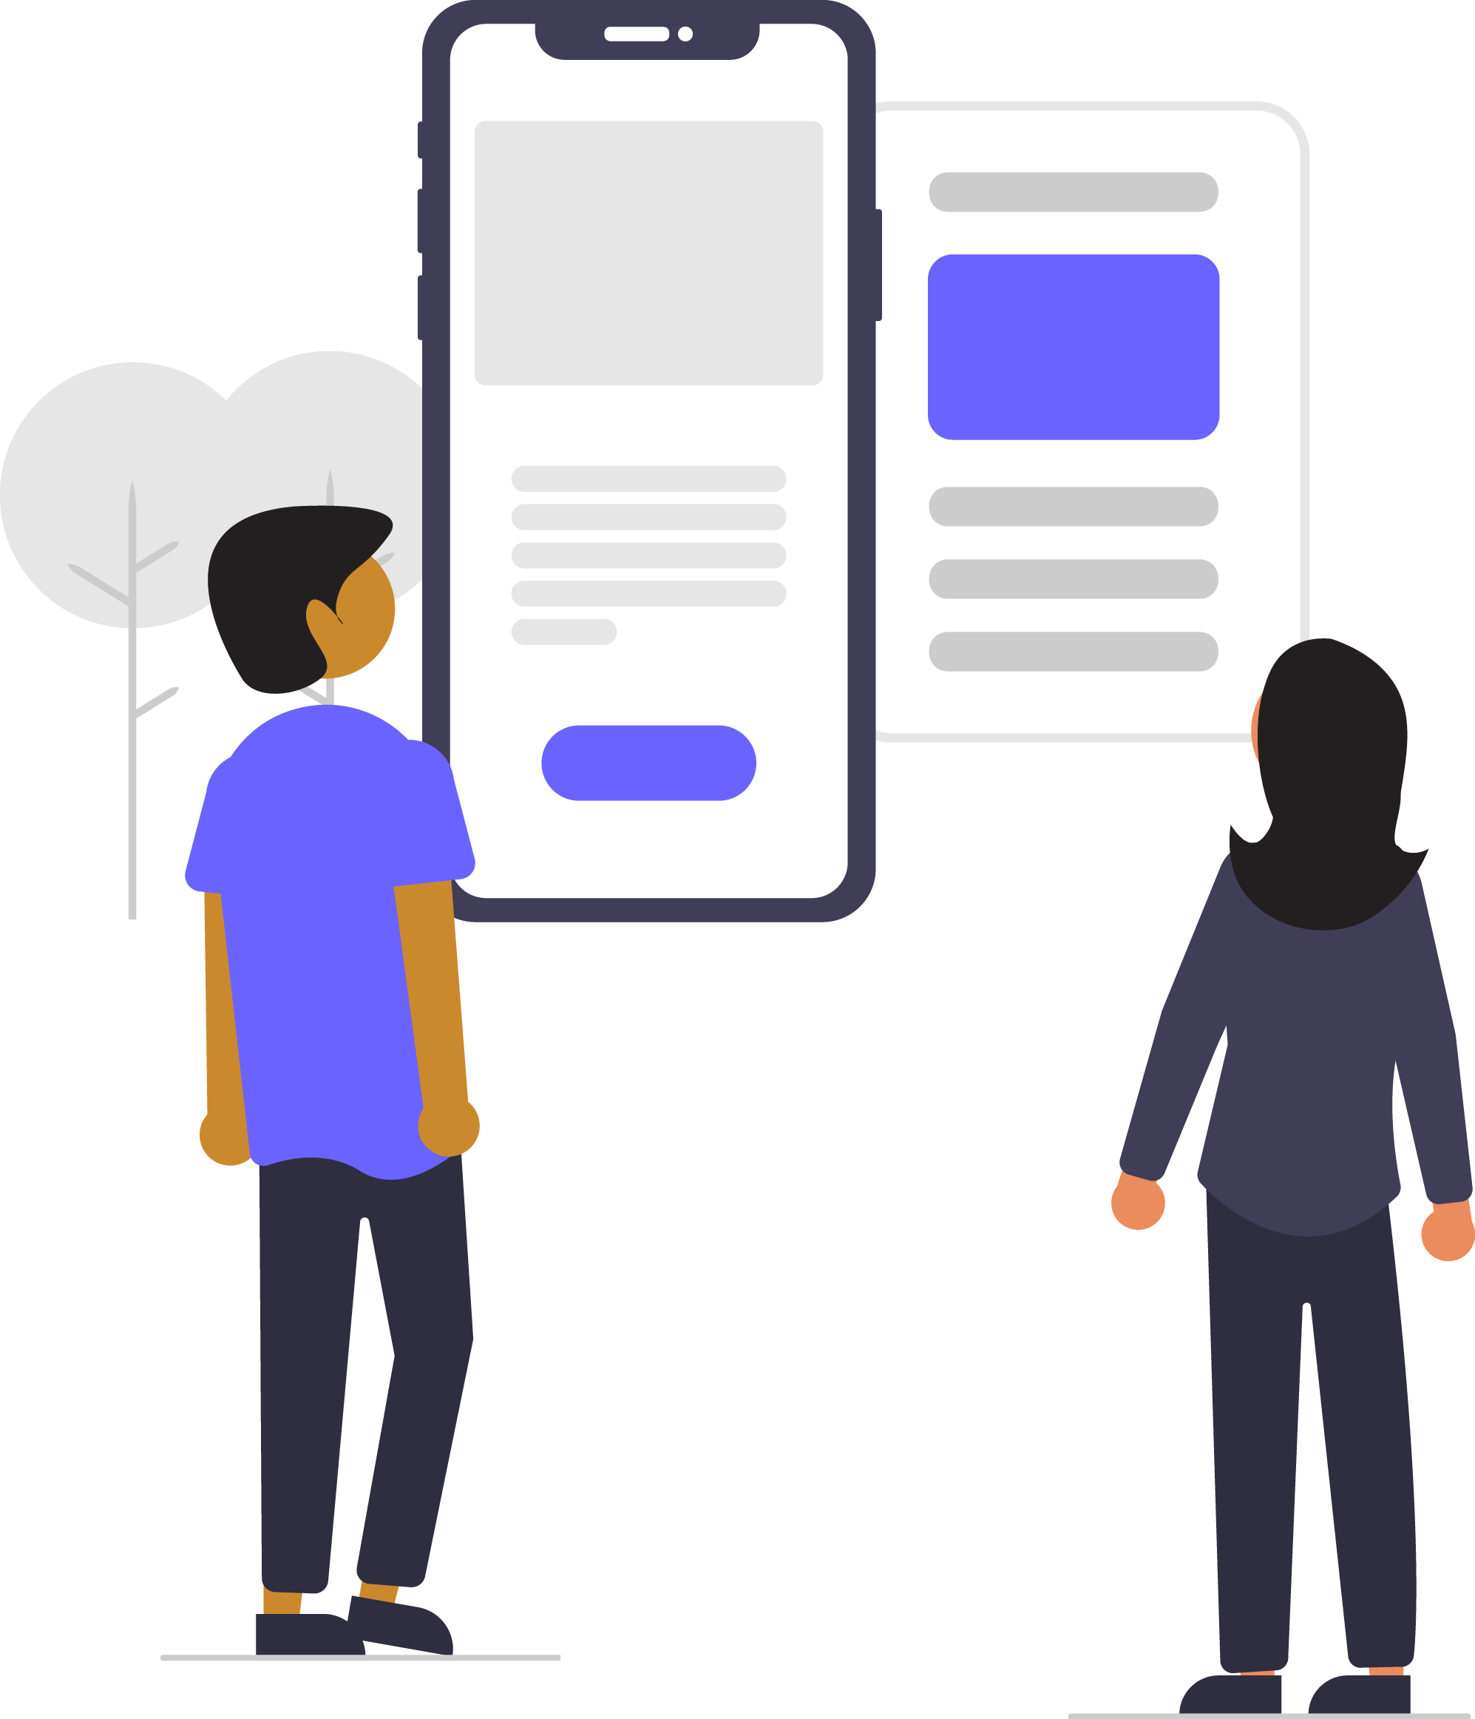
School:
City:
Date:

Slide 2

Hello
Full name
Title:
Organisation name:
Trainer, BBC Young Reporter India
Notes:
Trainer can add pic and details.

Slide 3
A media education programme for school students in India launched by BBC News in partnership with Internews and in collaboration with DataLEADS
Notes:
A media education programme for school students in India launched by BBC in partnership with Internews and in collaboration with DataLEADS

Slide 4
The programme will help students from grades 9-12 in schools across India critically assess online information and sift facts from fake.
Notes:
A media education programme for school students in India launched by BBC in partnership with Internews and in collaboration with DataLEADS

Slide 5
OUR AIM
To build a community of students, schools and teachers who will be able to sift facts from the fake and understand online information better.

Slide 6
House Rules
Please keep your mic on mute at all times
Use the chat box or ‘raise your hand’ button if you have any question
Keep your video on throughout the workshop
There will be time for Q&A at the end of every section
Please do not record the session or take screenshots during the workshop to allow a free discussion
Do not share any screenshots, or videos from this workshop on social media during the workshop.
We encourage you to share your learnings from this workshop with people after your training.

Slide 7
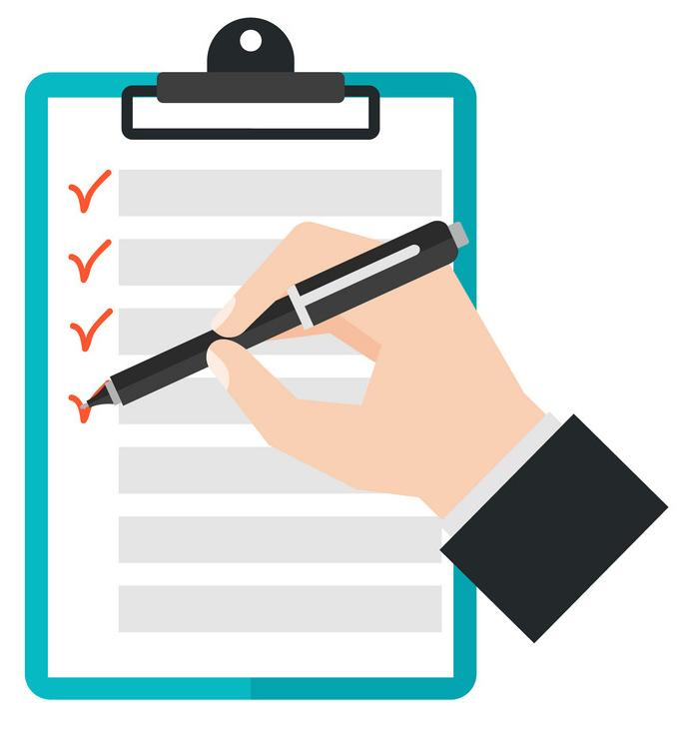
AGENDA
Introduction to ‘Fake News’
‘Fake News’ and its types
How do we check if it is REAL
Social media and image verification
Video verification

Slide 8

SECTION 1:
Introduction to ‘Fake News’

Slide 9
Ready to be a
‘BBC Young Reporter’?
Take the digital detective test
Are they REAL or not REAL?
Notes:
The next section is about a series of images that the students need to call “real” or “fake” using the “thumbs up” or “thumbs down” emojis on chat. You can engage the group in discussion as to why they are real or fake before revealing the answers. This will set their thinking up for the rest of the session.

Slide 10
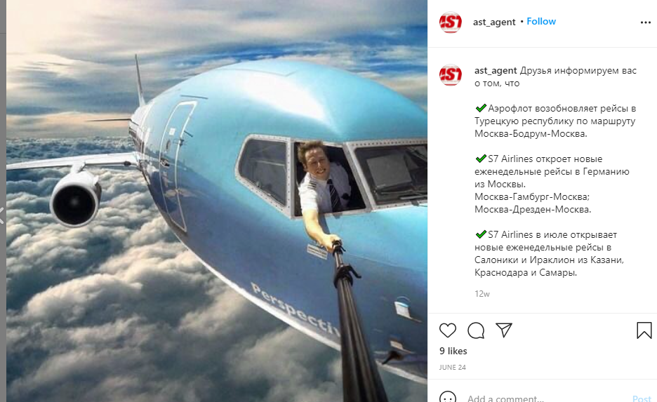


Real or Fake
A pilot took a selfie mid-air

Slide 11

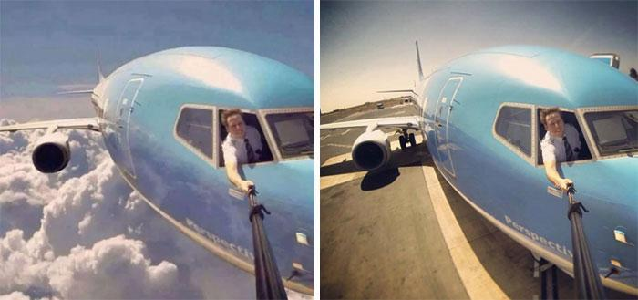
HOW DID I FIGURE THIS OUT?
WE LEARN THIS LATER
Fake. The photo was clicked before the flight had taken off

Slide 12
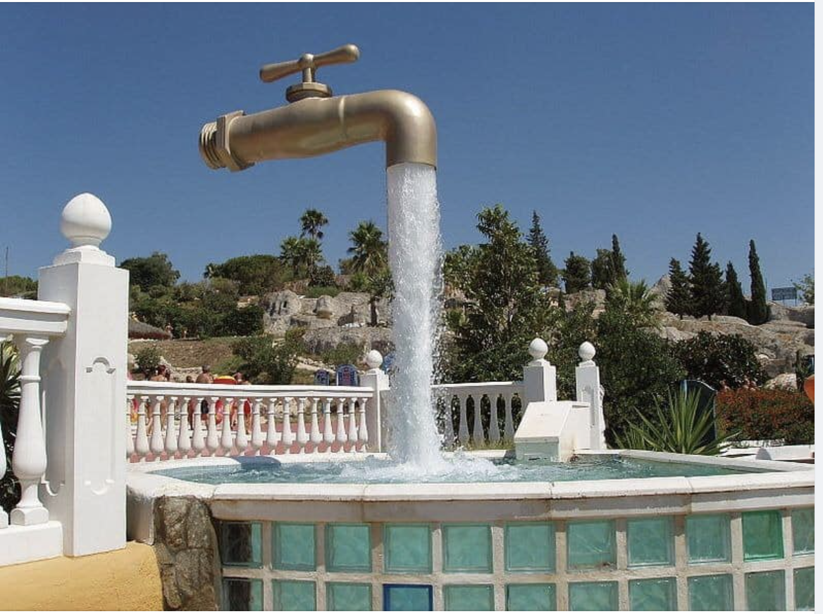
This is a “Magic Tap” Fountain.
Real or Fake

Slide 13
Real.
This “Magic Tap Fountain” is in Aqualand, Puerto de Santa Maria, Spain
HOW DID I FIGURE THIS OUT?
WE LEARN THIS LATER
Notes:
https://www.bigglobaltravel.com/trending/photos-stranger-fiction-fb/

Slide 14
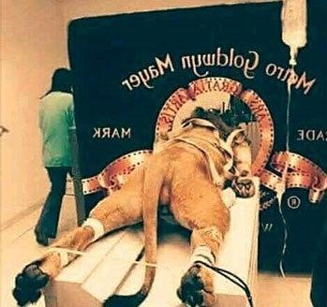
This is how the roaring lion in the iconic MGM intro was filmed.
Real or Fake

Slide 15
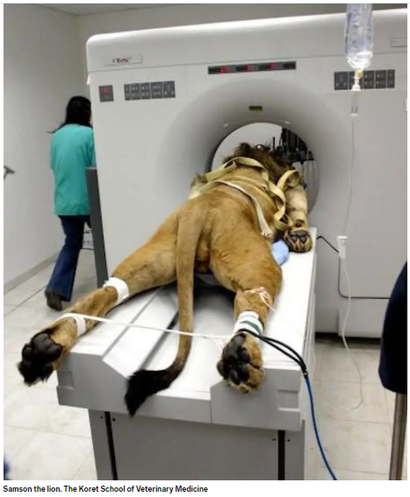
Fake.
This is the real image of a sick lion in an Israeli zoo, who underwent a scan in 2005
HOW DID I FIGURE THIS OUT?
WE LEARN THIS LATER
Image from: The Koret School of Veterinary Medicine
Notes:
https://www.snopes.com/fact-check/leo-the-lion-mgm-logo/
https://www.businessinsider.com.au/story-behind-the-lion-who-got-a-cat-scan-2015-10

Slide 16
What Was Your Score?

Slide 17

Sources of Information
Newspapers
TV
Radio
Websites
Social media
Messaging apps
Family & Friends
Notes:
These are a few daily sources of information which load us with all sorts of information - right or wrong(fact checked or not). Of late, there has been a tendency in the people to believe in the information reaching us from anywhere.

Slide 18
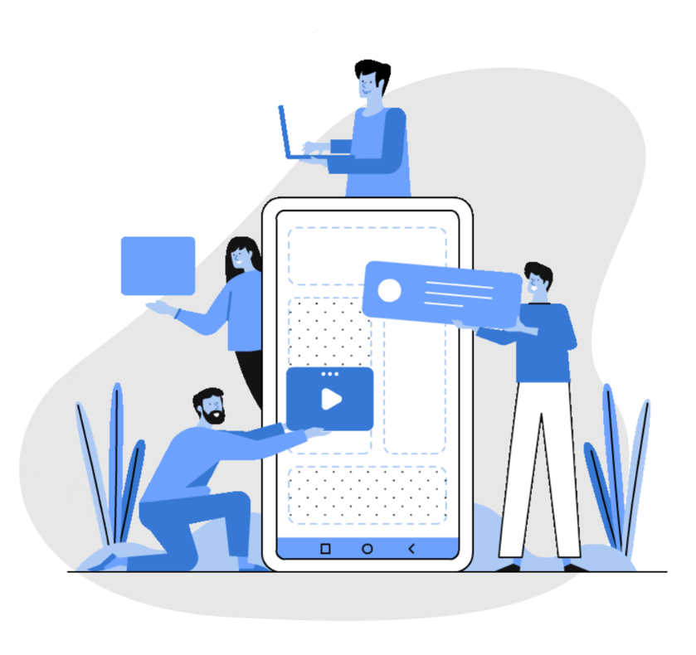
Information Deluge
35 cr photos uploaded on Facebook every day
50 cr people use Instagram stories every day
6000 tweets on Twitter every second
500 hours of videos uploaded on
YouTube every minute
(Source: statista.com- 2019)
Notes:
A few figures to highlight our engagement with various social media platforms.

Slide 19
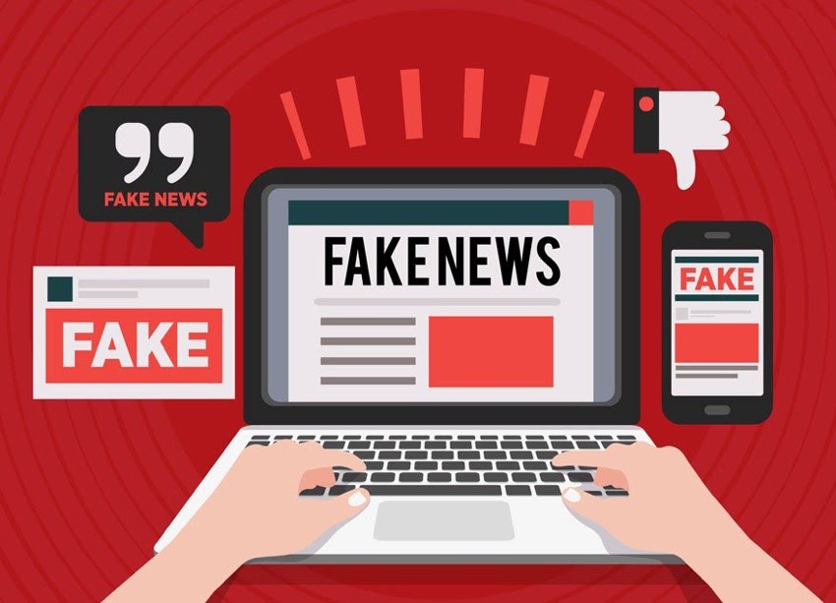
SECTION 2
‘Fake News’ and its types
Notes:
Moving on the next section - the Different types of misinformation or disinformation.
Well, you know why many consumers of news tend to believe false articles is because - for many many year, they are used to getting information from traditional news outlets, so they tend to trust anything that “looks” like news! Part problem is also because fake news comes in many garb - so it is difficult the fathom “by just looking at it”.
So let’s try look at the different types of content that are being created and shared, the motivations of those who create this content and the ways this content is being disseminated.

Slide 20
What is ‘fake news’?
Do you know what is ‘fake news’?
Did you ever fall for ‘fake news’?
What did you do with it?
Notes:
Open discussion exercise: Encourage participants to expand on their answers. Also ask participants for their definition of ‘fake news’.

Slide 21


Introduction to Fake News
Video Link
Notes:
Introduction to Fake News - BBC Video
Play video: runtime 4 minutes 15 sec
The video is self explanatory, you don’t need to add any details
Check the Beyond Fake News website

Slide 22
Misinformation
Misinformation – an umbrella term to describe
false misleading or out of context material regardless of the motivation behind it.
It can also be described as bad information.

Slide 23
Disinformation
Disinformation - a deliberate attempt to mislead using material that the deceiver knows is untrue.
• Designed to be widely shared
• The purpose is often to persuade people to think
a certain way, vote a certain way, or to make money from advertising each time someone clicks on a story

Slide 24
‘Fake News’
“Fake News” – A colloquial term widely used
across many languages.
Politicians and activists have used the term as an
insult against their opponents or a way to dismiss stories they simply don’t like, no matter whether they are factual or not.

Slide 25

Types of misinformation
False Context
Manipulated /Fabricated Content
Imposter
Satire/Parody
Clickbait
Online Scam/Malware
Notes:
False Context: Great example is the film clip of Contagion being used as corpses dumped in Italy today
Factually Incorrect: No scientific theory or data to support it
Manipulated / Fabricated Content: Video or Image digitally altered (not Photoshopped) to suit a narrative
Imposter: Using credible handles to spread disinformation
Satire/ Parody: Intentionally false, and intended to entertain
Clickbait: Headlines that bait you into reading the contents, although in most cases the headline and the content dont match
Online scam /Malware: Online scams that bait you into sharing your bank details and/or end up in a phishing attack

Slide 26
How can images deceive you?
They could be
Manipulated to suit a new story
Presented out of context
Designed to create panic, or fear
All of these can potentially lead to chaos, unrest, and sometimes violence.

Slide 27
Look at this next video:
Is it real?
Is it misinformation?
Is it disinformation?
Is it manipulated content?

Slide 28
Have you seen such disciplined ducks before?
Video Link
Notes:
This becomes a fun example of misinformation….

Slide 29
So what did you think?
Is it real?
Is it misinformation?
Is it disinformation?
Is it manipulated content?
Notes:
Get the group to debate. Ask for individual responses and the reason for those responses.

Slide 30
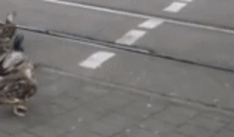
This was for a traffic educational video and not real.
FABRICATED
CONTENT
Notes:
Point out how one of the ducks is gliding and not walking
Reading reference : https://observers.france24.com/en/20180531-ducks-video-manipulated-doctored-debunked

Slide 31
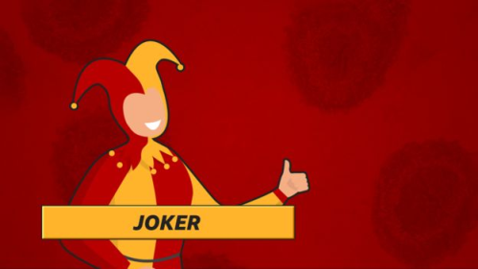
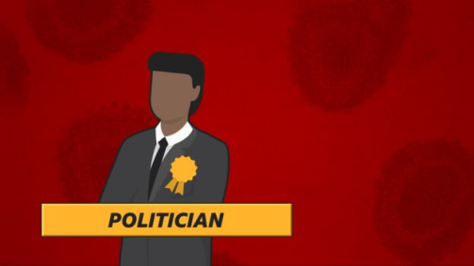
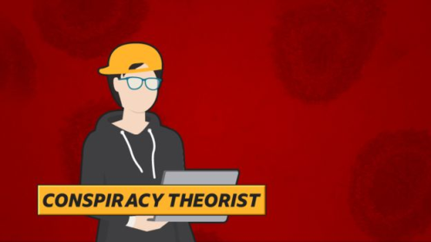
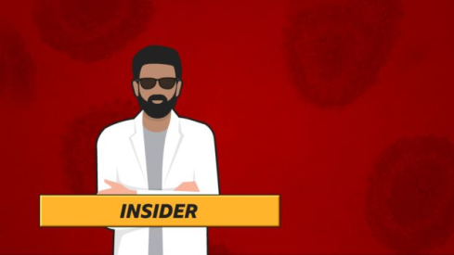
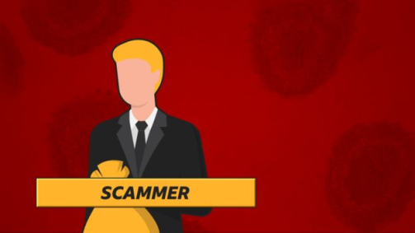
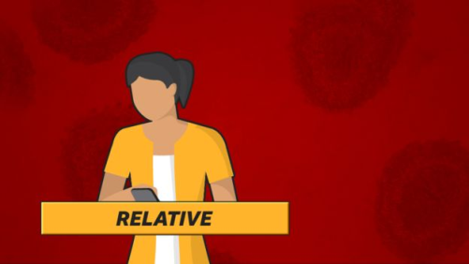
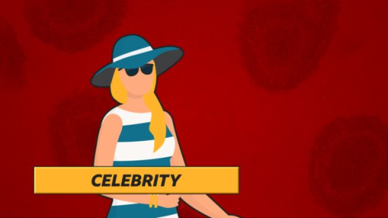
Who makes it? Who shares it? – And why?
Notes:
In terms of where it comes from and how it is spread, the UK workshop looks at who is creating and sharing this information – because if you know why and how it got there, it may well help you spot it.
The BBC’s disinformation team – who help to spot and debunk misinformation and disinformation - have identified seven types of people who create and spread false information and get it to go viral. Here they are:
the joker, the politician, the conspiracy theorist, the insider, the scammer, a relative (including friends and family) and celebrities. And in the UK workshop, we take a look at an example of each - linked to their creating and sharing of misinformation around Coronavirus.

Slide 32
Motives For Sharing False Information
Mistake - Genuine Error
Satire - Harmless entertainment
Publicity - Propagating a cause
Financial - Usually scams
Ideological - Propagating cause about faiths or community
Political motives - Plying political narratives
Psychological biases - Deep personal likes and dislikes
Cultural backgrounds - Family orientation, cultural settings and values.

Slide 33
Why is social media prone to misinformation?"
NEWS
SOCIAL MEDIA POSTS
Checks before publishing
Editor is in-charge
Legit source quoted
No gatekeeping
Algorithm is in-charge
Often no source is quoted
Notes:
The trainer should be aware that the group may ask questions on how credible is traditional media today?

Slide 34
SECTION 3:
Tools that help verify

Slide 35
Tools that you can use to verify
THIS IS HOW WE DO IT
The “REAL” check : Observe and think before you share
5 W’s and 1 H: The journalist’s questions
Click Away: Start verifying a post
Other important tools:
  Text Search
  Reverse image search
  Verifying videos using InVID

Slide 36

Source Check

Slide 37
Who do you trust?
Where do you get your news and information from?
Notes:
Name different types of sources

Slide 38
What and who to trust?
Video Link
Notes:
BBC Video: How to Fact Check

Slide 39

People tend to trust
any information they get from friends, family
and people they respect, without evaluating their authority on the subject
Notes:
Ask the students for examples on how they have seen people blindly accept any information because it is coming from a certain source they respect.

Slide 40
Authoritative Sources
Whose advice will you seek for the following?

Slide 41
Language test in school ?
Weather Conditions?
Covid-management related ?

Slide 42
EXERCISE 3
Notes:
The next exercise is the Traffic Light exercise. Take them through the examples given and ask whether they trust the source and would forward as is, think about the source, or not forward the post at all.

Slide 43

Who To Trust? Traffic Light Exercise
What are the sources of information we should trust, we should be wary of and we should never trust
PROCEED | WARNING SIGNAL | STOP
Official Statement | Statement without attribution | Statement without evidence
Notes:
Task: Students will be asked to make a list of different sources of information and divide them into 3 parts:
Trust = Put these sources into green column, which is Proceed
Wary of = Put these sources into yellow, which is Warning Signal
Never Trust = Put these sources into red, which is stop

Slide 44
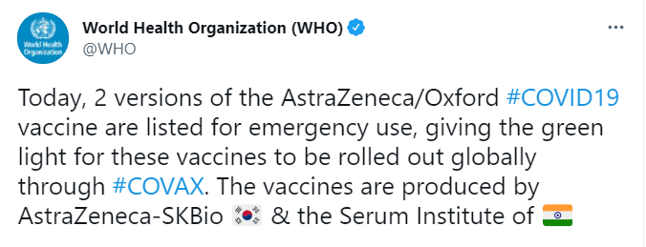
STOP
WARNING
PROCEED

Slide 45
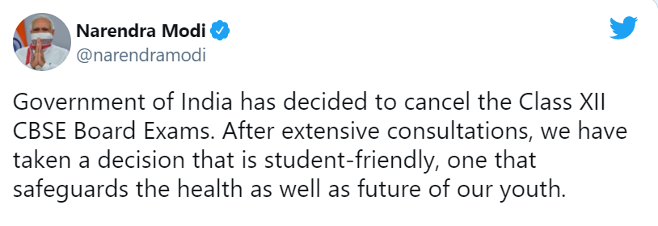
STOP
WARNING
PROCEED

Slide 46
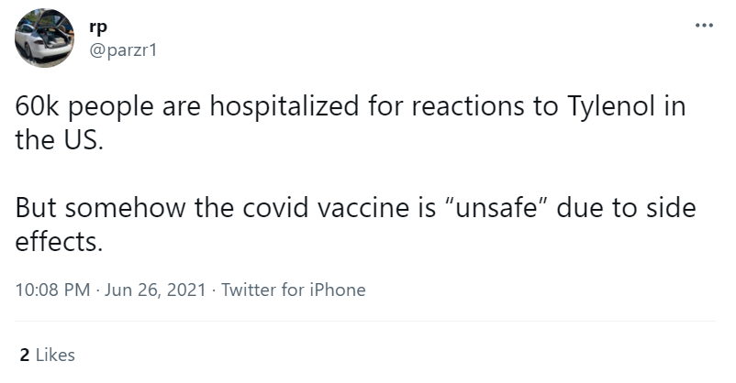
STOP
WARNING
PROCEED

Slide 47
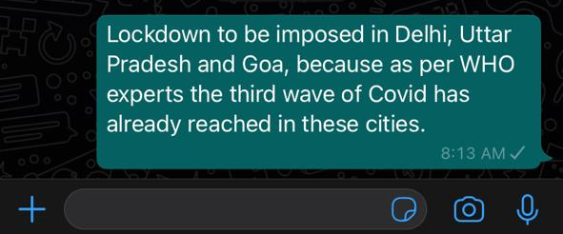
STOP
WARNING
PROCEED

Slide 48

REAL Checks
REAL
EVIDENCE
Is it real?
What is the source?
Ask around, use your knowledge
Any other sources carrying the story?
ADD IT ALL UP
LOOK AROUND
Notes:
Sum it up….

Slide 49
BBC Video: The REAL check
Video Link

Slide 50
The REAL Checks – Four Steps
Real: “Is this real?”
Evidence: Check the source, author, publication, web address, date & time, pictures, text, names (5Ws, 1H)
Add it all up: Does it add up with what you knew or can find out ?
Look around: Check other sources to see if they are carrying the story
Notes:
SCRIPT
These are the checks we have been doing…. [CLICK] through each step
Read through slide
All these checks help you build a picture, like putting a puzzle together, to help you decide if what you were seeing and reading was real, or not.
[CLICK]
And if you look at each of those steps you can see that you have spelt out the word REAL, to help you remember your check list.

Slide 51
The journalist’s questions
Who?
Who wrote it? Who published it? Who sent it?
Who else has this story?
What?
What is the story? What is the evidence?
What is the motive?
Where?
Where else is this information? Where else have I seen this story? Where else does this photo appear?
When?
When did this happen? When was it written? When was the photo taken? When did I receive it?
How?
How does it want me to feel or think? How does the author know?
Why?
Why have I been sent it? Why has it been written?
Notes:
There are 6 questions that journalists all over the world are taught to ask of a story or piece of information and they are; who what where when how and why. Using these words and pushing yourself to form a question using this words, is a good way to get to the bottom of the story.
Let’s try…

Slide 52

2 Sources Rule
Notes:
Journalists and news organisations tend to ensure they have two sources they believe are reliable before running a story
Bring in the journalist in the room to explain/ or give your own example: The rule means that when sourcing information, a fact isn't credible unless it can be verified by two different sources.
We as citizens should operate as mini journalists
Now let’s look at the different types of information that we encounter

Slide 53
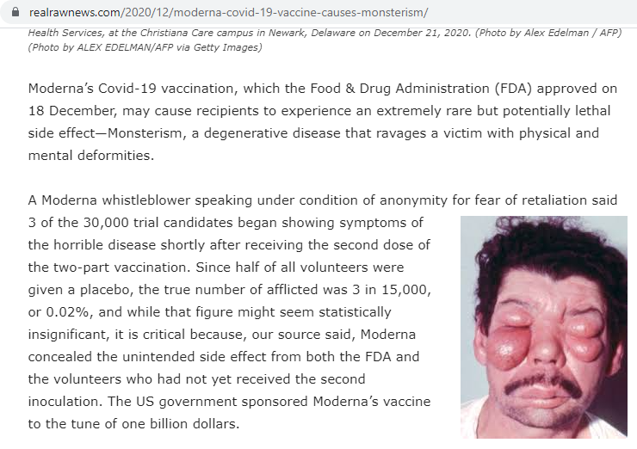
Does Moderna’s Covid vaccine cause “monsterism”?

Slide 54
Here’s what the
article said

Slide 55
Let us do the “REAL” Check here
R: Does it appear to be real?
E: Is there evidence that the post quotes?
A: Add it all up - ask around, have you heard of this before?
L: Look around, can you see many legit sources carrying this?
Notes:
Elicit answers for each question. This will help clarify each point of REAL to the group

Slide 56
Let’s do the ‘REAL’ test
R- Does it appear REAL?
Looks a little suspicious/odd!

Slide 57
Let’s do the ‘REAL’ test
R- Does it appear REAL? Looks a little suspicious/odd!
E- What is the EVIDENCE? - Check the source, author, publication, web address, date & time, pictures, text, names

Slide 58
Let us check realrawnews.com

Slide 59
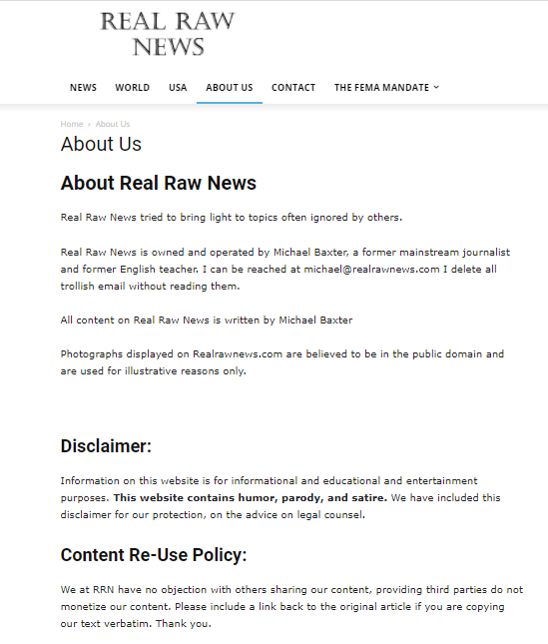
This is the “About” page of realrawnews.com

Slide 60
‘REAL’ test Takeaway
Is it REAL: Looks a little suspicious/odd!
What is the EVIDENCE? - It’s hosted on a satire/parody website.
Add it all up: Have you heard about it?
(No, there is no common knowledge )
Look Around: Any other sources carrying it?
(None. No other legit sources carrying it)
RESULT: It fails the REAL test.

Slide 61
SECTION 4:
Tools and Techniques for
Social Media and Image Verification

Slide 62
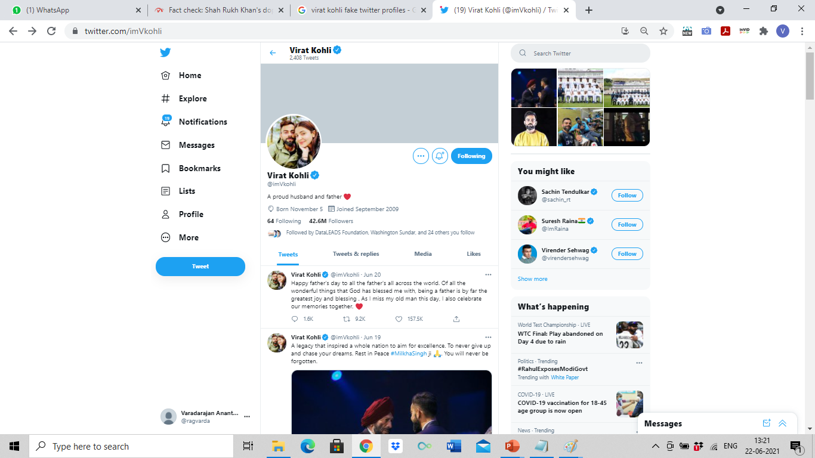
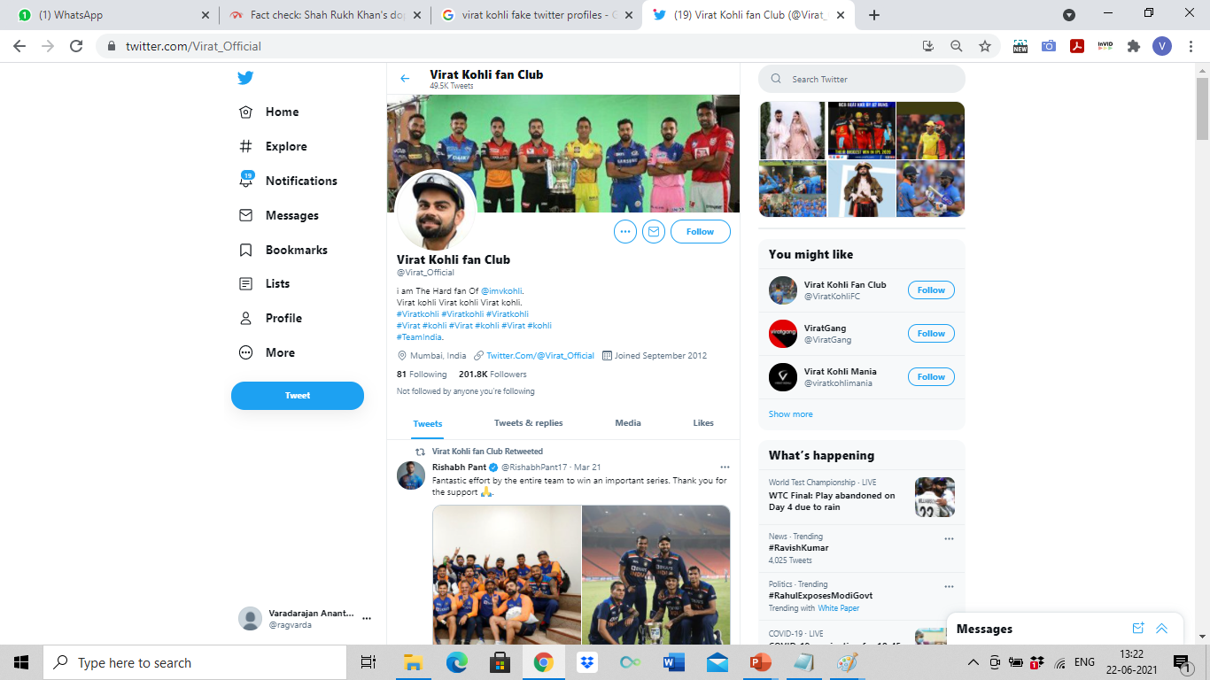
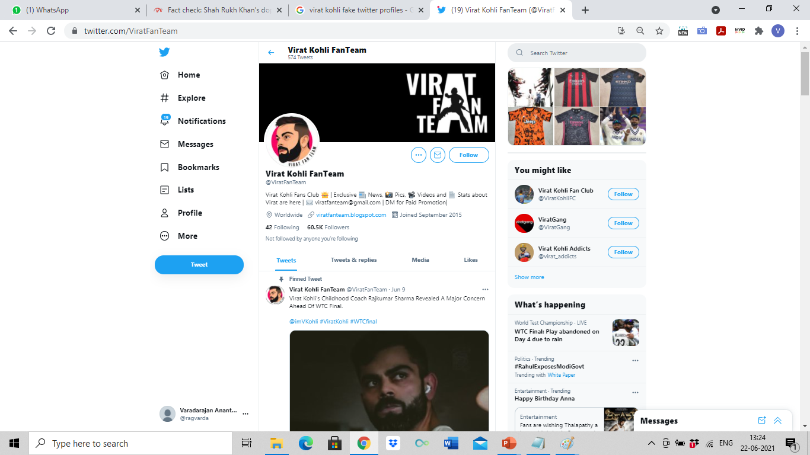
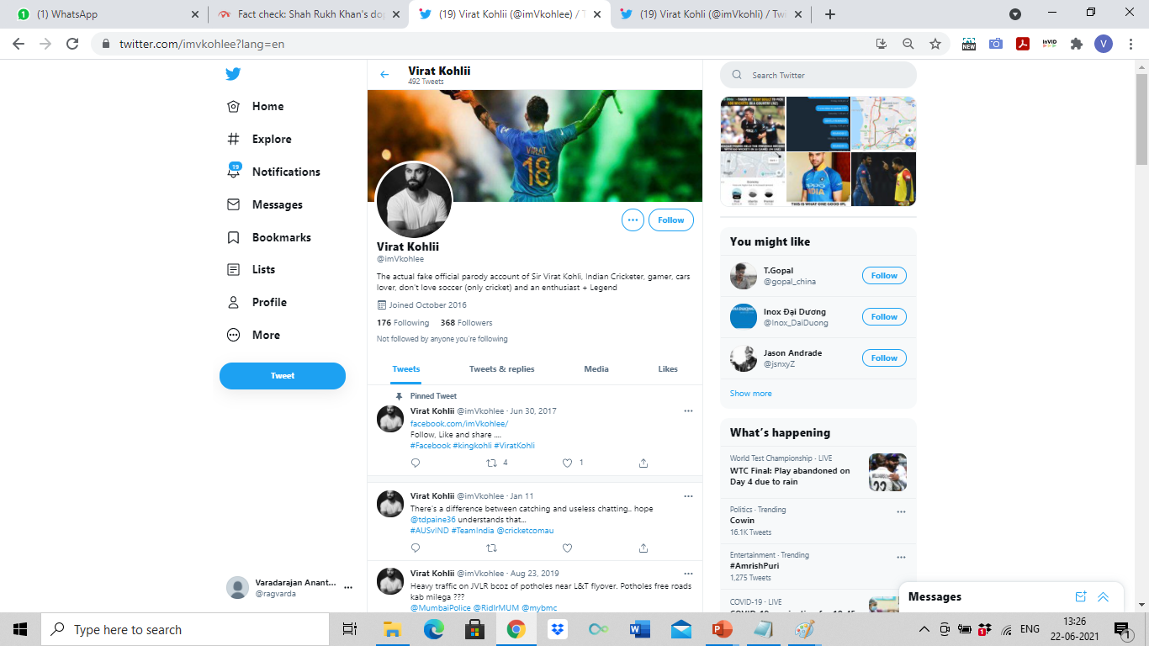
Can the real Virat Kohli, please
stand up?

Slide 63
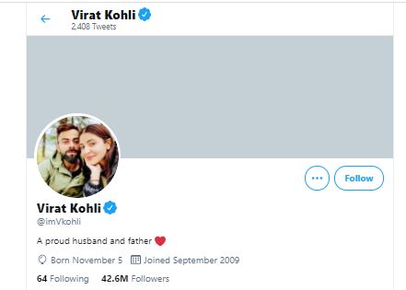
Notes:
There are many fake accounts – encourage students to look at the numbers of followers and tweets for some and consider the consequences of a fake account with thousands of followers ad how they may influence understanding of policy etc. When was account created? Does the account link to their website? Or websites that you trust? And do those websites link to the account?

Slide 64
‘Click Away’ To Look Around
Notes:
‘Click Away’ is what you do when you are looking at a probable piece of misinformation, that needs verification. You ‘Click Away’ from the information, and look for evidence, or the lack of it, from other sources.

Slide 65
Text Search:
On Google, Bing, Yahoo
Sometimes, all it takes to reach
the truth is a quick search on web
Notes:
Stress on the importance of Text Search - to add what they see on the post, as text and do a text search on any search engine.
Or other search engine!

Slide 66
Do a simple Text Search on Web
Look at what other sources are saying
Check authoritative sources and official websites
Notes:
Stress on the importance of looking at authoritative sources and official websites

Slide 67
Pro Tips To Search Better:
Use keywords to search
Describe subject/image in 3-5 words
Use “double quote” marks for focussed results and search operators
Notes:
Stress on the importance of keeping the search phrase short, and focussed.

Slide 68
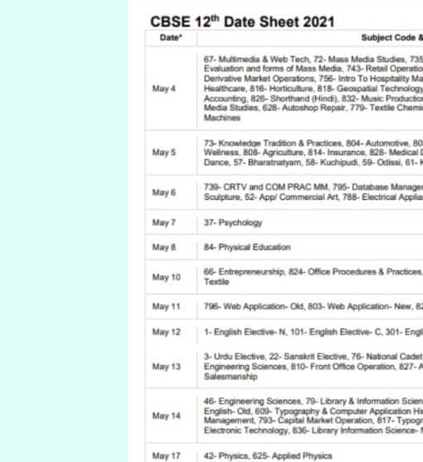
This is the date sheet for Std
XII Boards.
True or False?
Notes:
Demo this example using text search

Slide 69
Different approaches to check:
Carefully observe who is sharing the date sheet: Are they authorised sources?
Always check with authentic sources. In this case, CBSE / School website
Search for “CBSE Class XII datesheet”
Notes:
Do a text search demo for “CBSE Class XII datesheet”

Slide 70
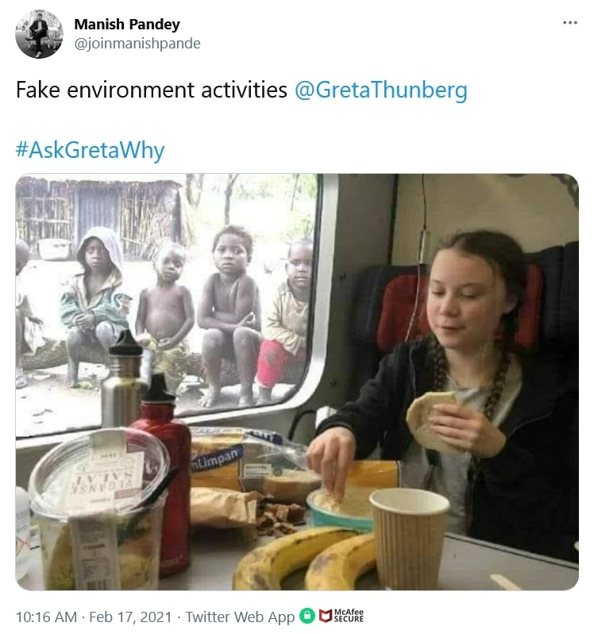
Did environment activist Greta Thunberg have food as poor children looked on?

Slide 71
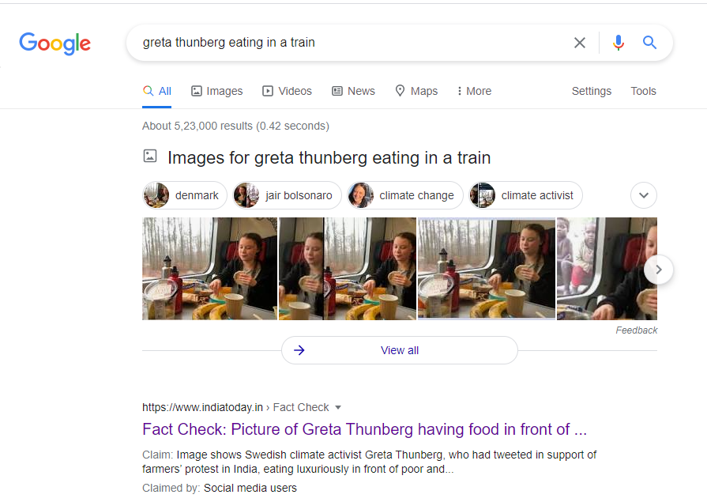
Search with the phrase “Greta Thunberg eating in train”

Slide 72
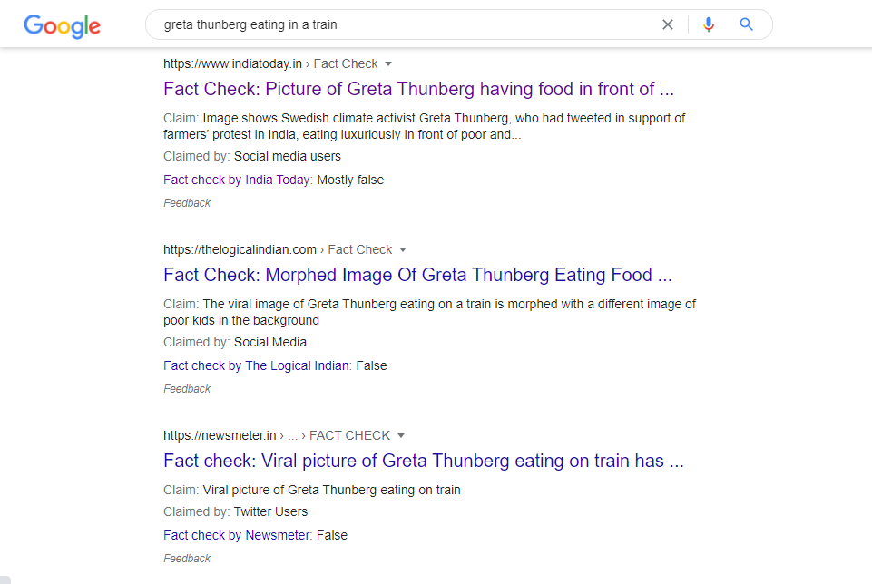
Search with the phrase “Greta Thunberg eating in train”

Slide 73
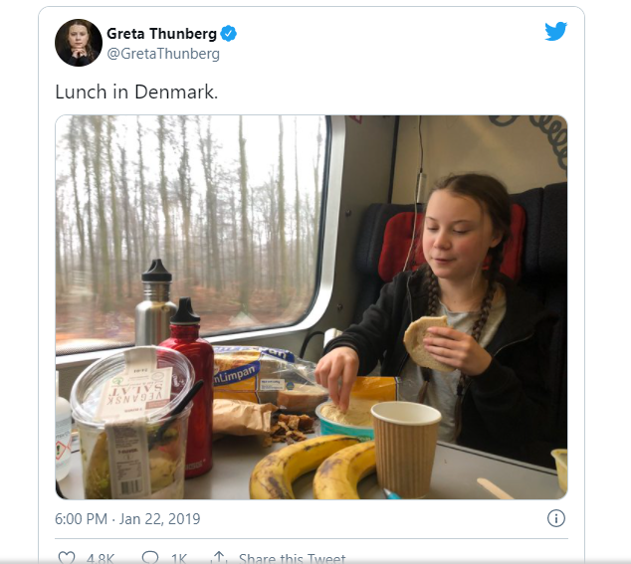
This is the original image.
The true picture
Notes:
Provide this image as an attachment to the group.
Google Search gives you the result on Page 6 – tell the group to be diligent and adamant
An AFP Fact Check article will give the result

Slide 74
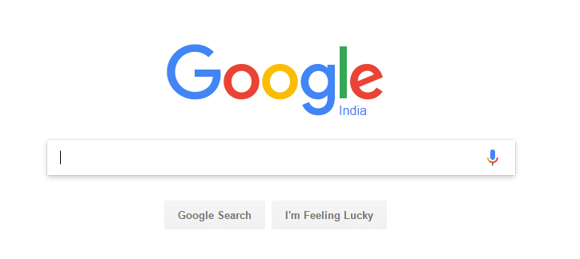
Reverse Image Search

Slide 75

How does Reverse
Image Search help?
Was an image previously present on the Net?
Has an image been manipulated to suit a new story?
Is an image being presented with a different context?
Is the image genuinely from the source it claims to be?

Slide 76
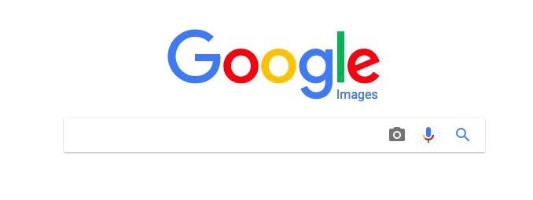
Google Reverse Image Search

Slide 77
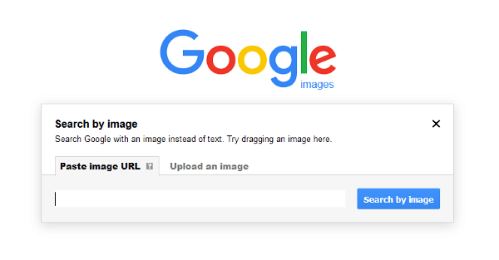
Upload the image on the search

Slide 78
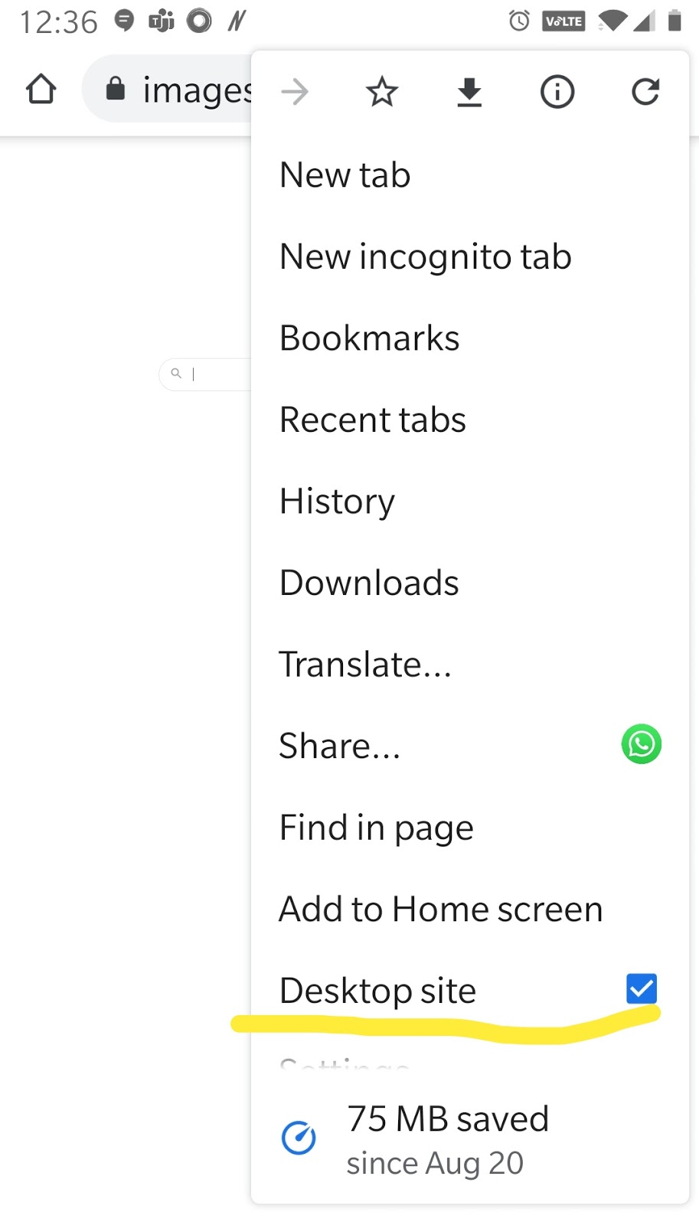
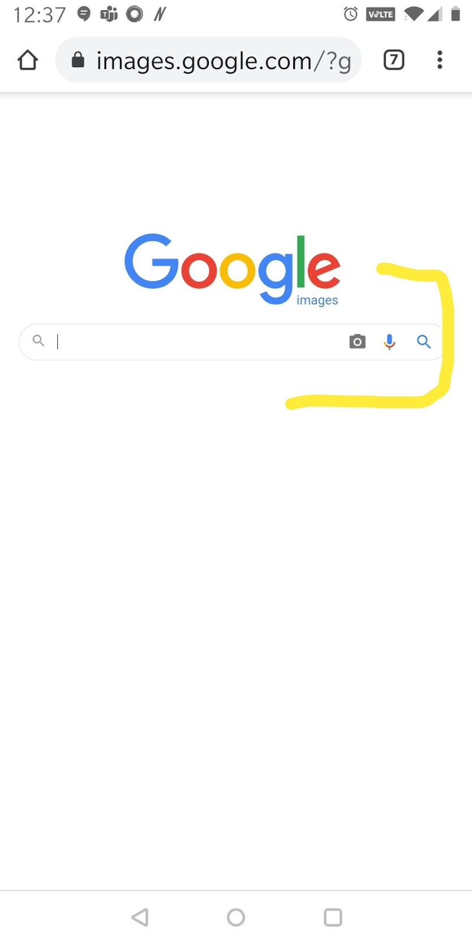
To use Google Reverse Image Search on mobile, go to desk top site

Slide 79
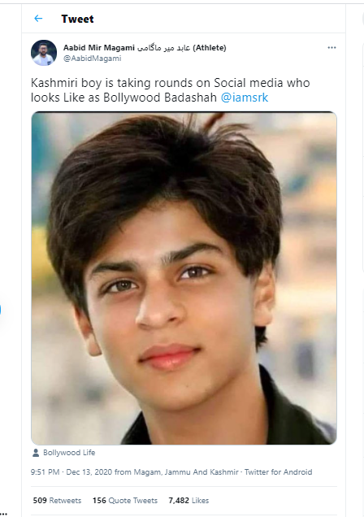
This is a look-alike of Bollywood actor Shahrukh Khan from Kashmir.
True or False?

Slide 80
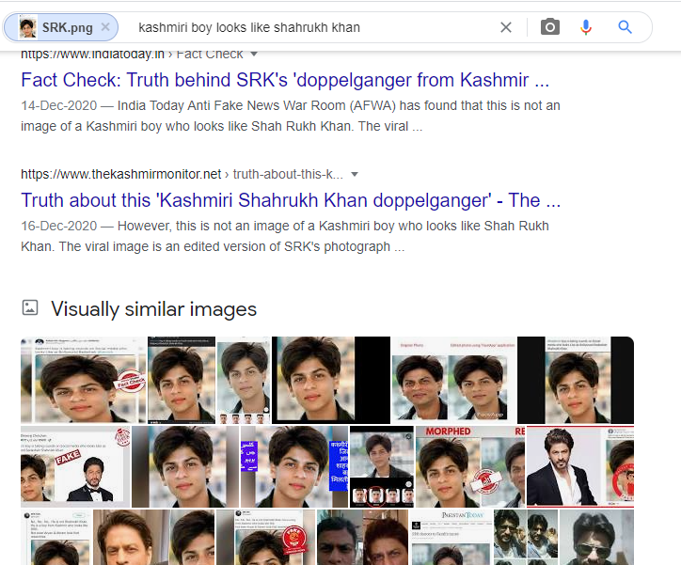
When you Reverse Image Search you get these results

Slide 81
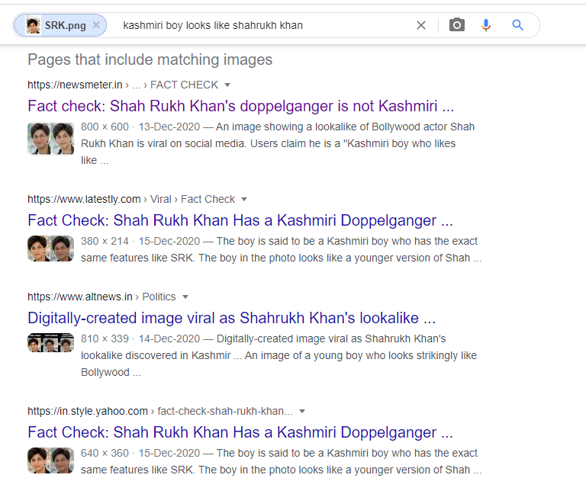
And these results

Slide 82
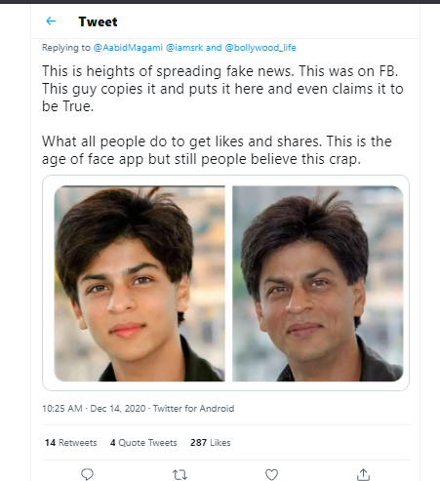
The image, in reality, is a digitally generated one, by an app.

Slide 83
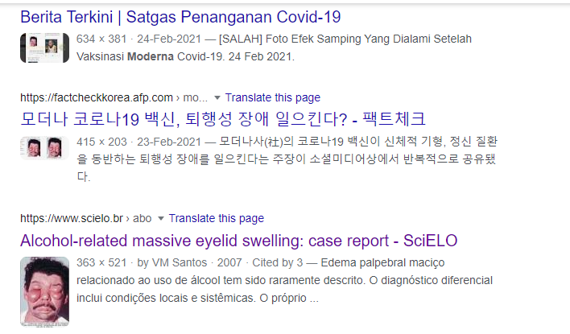
Remember the post that said “Moderna vaccines cause monsterism”
Doing a “Reverse image search” gets us the results as well

Slide 84
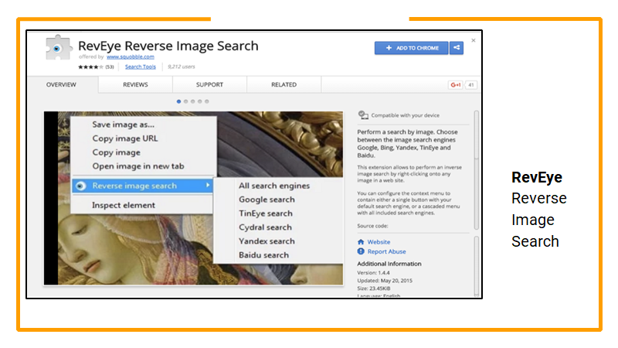
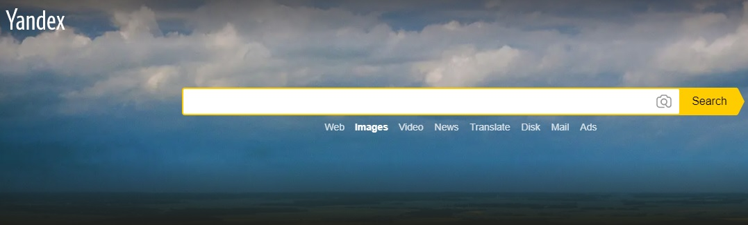
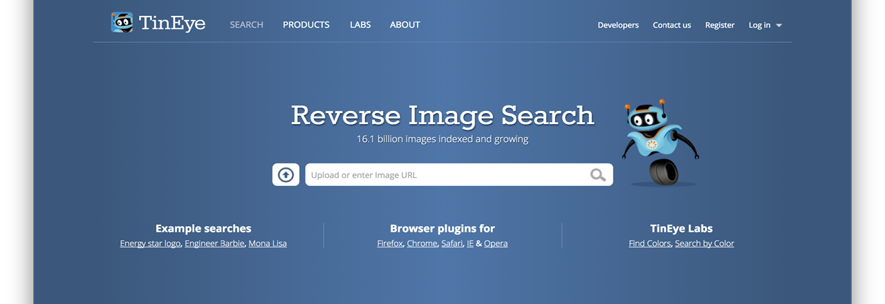
How to verify images
GOOGLE REVERSE IMAGE SEARCH
REVEYE – PART OF INVID CHROME EXTENSION
YANDEX REVERSE IMAGE SEARCH
TINEYE REVERSE IMAGE SEARCH
Notes:
EXPLAIN google reverse image and add yandex tineye

Slide 85
Image Verification: Exercises

Slide 86
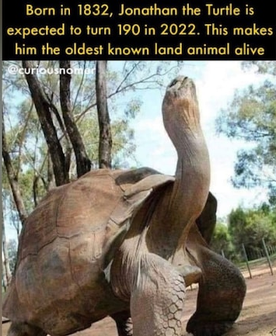
This is Jonathan the tortoise - the oldest living animal today.
True or False?
Notes:
https://www.indiatoday.in/fact-check/story/fact-check-this-is-not-jonathan-the-tortoise-world-s-oldest-living-animal-1820912-2021-06-29

Slide 87
Top tips for verifying photos
Ask: Is it REAL?
Does this picture appear anywhere else?
Try text search, reverse image search to find context
Observe signs, shop names, posters, car registration, landmarks
Clothing, behaviour, people’s expressions

Slide 88
SECTION 5:
Video Verification and INVID

Slide 89
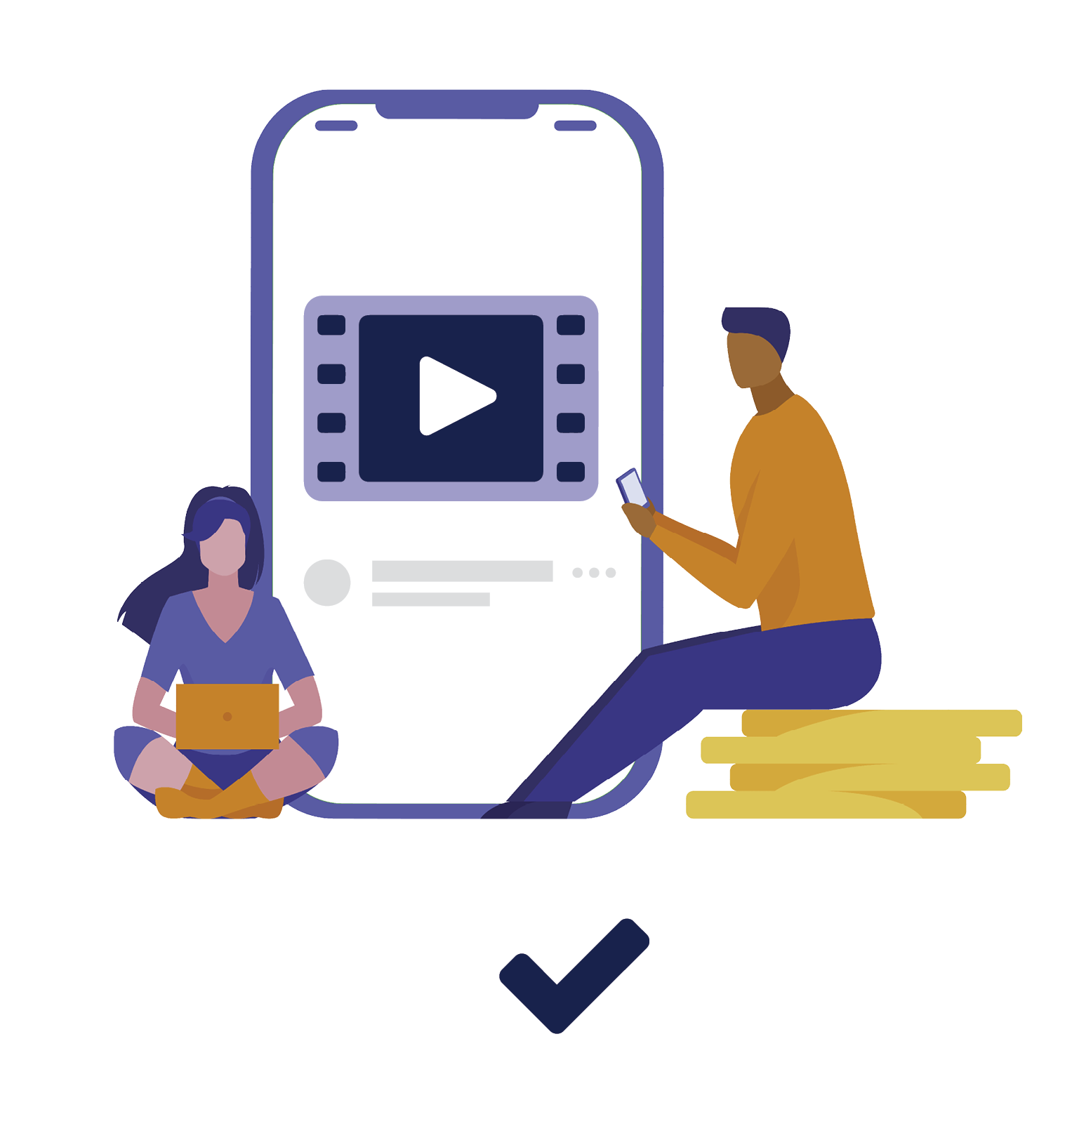
Why is video verification important?
Consumed, believed and trusted easily
Create instant panic, and chaos
Can quickly go viral and cause harm
Can be smartly edited solely to spread misinformation
Repurposed with new narratives

Slide 90
Remember: You can use “text search” to verify videos too
A simple text search of what you see in the video can get you to the actual video
Make sure you use minimum words for the search phrase - this will give you focussed results

Slide 91
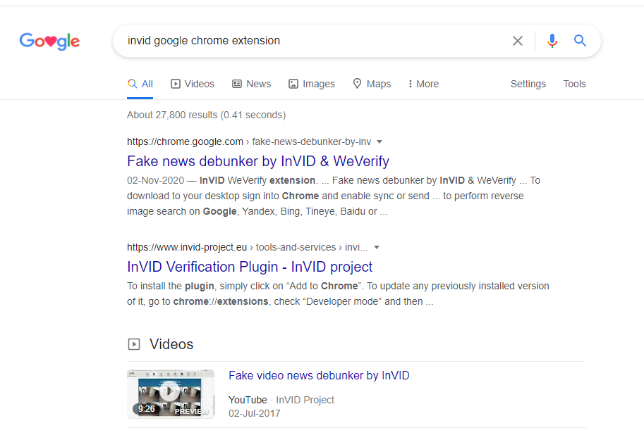
To begin with, download the InVID Chrome Extension

Slide 92
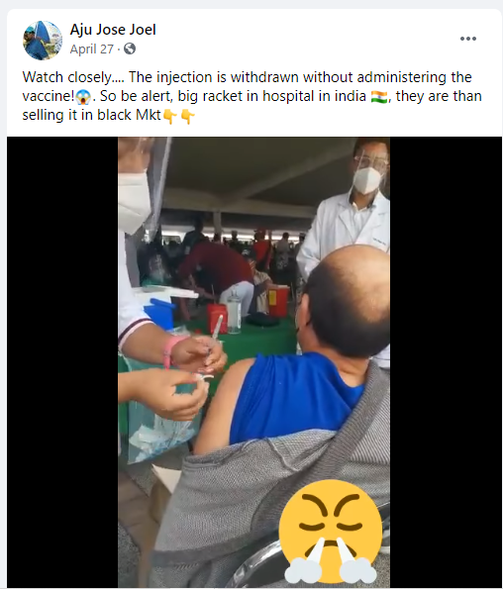


This video was shared as vaccine fraud in India, where the vaccine is not being administered at all.

Slide 93

Using InVID, we break down the video into keyframes, and then use these still frames to do Reverse Image Search

Slide 94

We get results in Spanish language, alerting that this video may not be from India

Slide 95

Sure enough, this is a video from Mexico, and has nothing to do with India

Slide 96
In reality, this video is from
Mexico, and not India as is claimed in the social media post

Slide 97
Video Verification: Exercises

Slide 98
Is this a video of the Thai Health Minister hesitating to take the vaccine?
Video Link

Slide 99

This is a 2019 video of a Chinese man scared of taking an injection
Notes:
Original video link: https://www.youtube.com/watch?v=Auc5bSm2iMU

Slide 100

Top tips for videos
Check if the video is edited shorter and taken out of context
Check when the video was originally posted, since it might be re-used
Check where the original video was posted, as videos can be taken out of geographical and cultural context
Check the original tags, as they may be deliberately mislabeled

Slide 101
Summing Up
Always ask if it is REAL?
Check if sender is a credible source
Ask important questions about 5Ws, 1H (source, date, motive)
Use “Text Search” first

Slide 102
Top Tips To Stay Safe Online
Behave like it’s real life …

Slide 103
Tips for being secure online
Muddy feet: You leave a digital footprint all the time. Use “Privacy Settings” and “think before you post”
Seek Help! know how to report to service providers and use blocking and deleting tools.
Upset online? it’s never too late to tell someone, ask a trusted adult
Respect the law: use reliable services and know how to legally access the music, film and TV you want.
Remember what you post can be there forever. So don’t post anything you wouldn’t want Grandma to see!
Beware of writing things in haste that you may later regret

Slide 104
Tips for being secure online
Who are you? Do not accept friend requests from people you may not know
Who am I? Never give out personal information, like your number, where you live or what school you go to
Never engage with a bully or a person who trolls you
Never participate in group trolling against others
If you get responses that are threatening in nature, bring it to the notice of elders
Make sure you “unfollow” and “unfriend” people who indulge in unacceptable online behavior.
Never let your password be “12345” and the likes
Have a healthy diet both on and offline

Slide 105
Thank You

Slide 106
EXERCISE 5

Slide 107

Fact-checking memory test
Participants will be given 45 seconds
to write down all the key themes, approaches, concepts and tools discussed during the workshop.
The student who comes up with the maximum number will be the winner.
Notes:
They will send their answers to class teacher/ school coordinator, which will be further sent to the DataLEADS Team.

Slide 108
POST-WORKSHOP
ACTIVITY PLAN BRIEF

Slide 109
Discussion: Sharing workshop learning
How will you share learning with friends
How to detect fake news? Your advice
3 Tips for your family and friends
One minute video
Notes:
Task: Open House. They will be asked suggestions on how they can guide their family on debunking misinformation.
Each student will list different ways and strategies to help her/his families to identify misinformation/false information.

Slide 110
Teen Fake-Buster Champions
The best way to implement your learning is to action an exercise
Works as individuals or as groups and think of creative ways of how you will share what you learnt in this workshop today with other students of your school and / or your family
Each student / group can pursue any one activity and submit it share the document/file to your designated teacher
The teacher may share 5 best entries that will get a chance to be featured in a BBC Young Reporter India newsletter under the “Teen Fake-Buster Champions” section.
Students who produce these activities may get a chance to participate in our future Townhall events

Slide 111
SUGGESTED ACTIVITIES ONLY!
Slogan Writing or Radio Jingles
Write a slogan or a radio jingle encouraging people to not fall for misinformation and fact-check all information.
It needs to be catchy and rhyming.
Letter Writing
Write a letter to the oldest member of your family and enlighten them about responsible consumption of news. Share with them tips on how they can fact-check news or messages they receive through different social media or communication platforms.
Assembly Speech
Prepare a school assembly speech capturing the highlights of the ‘BBC Young Reporter India’ workshop you attended. Followed by relevant tips and techniques students can use for fact-checking any misinformation.
Banner or Cartoon Script
Prepare an informative banner or a cartoon script sending out a message about tackling misinformation and being vary of misleading messages and news.

