Slide 1


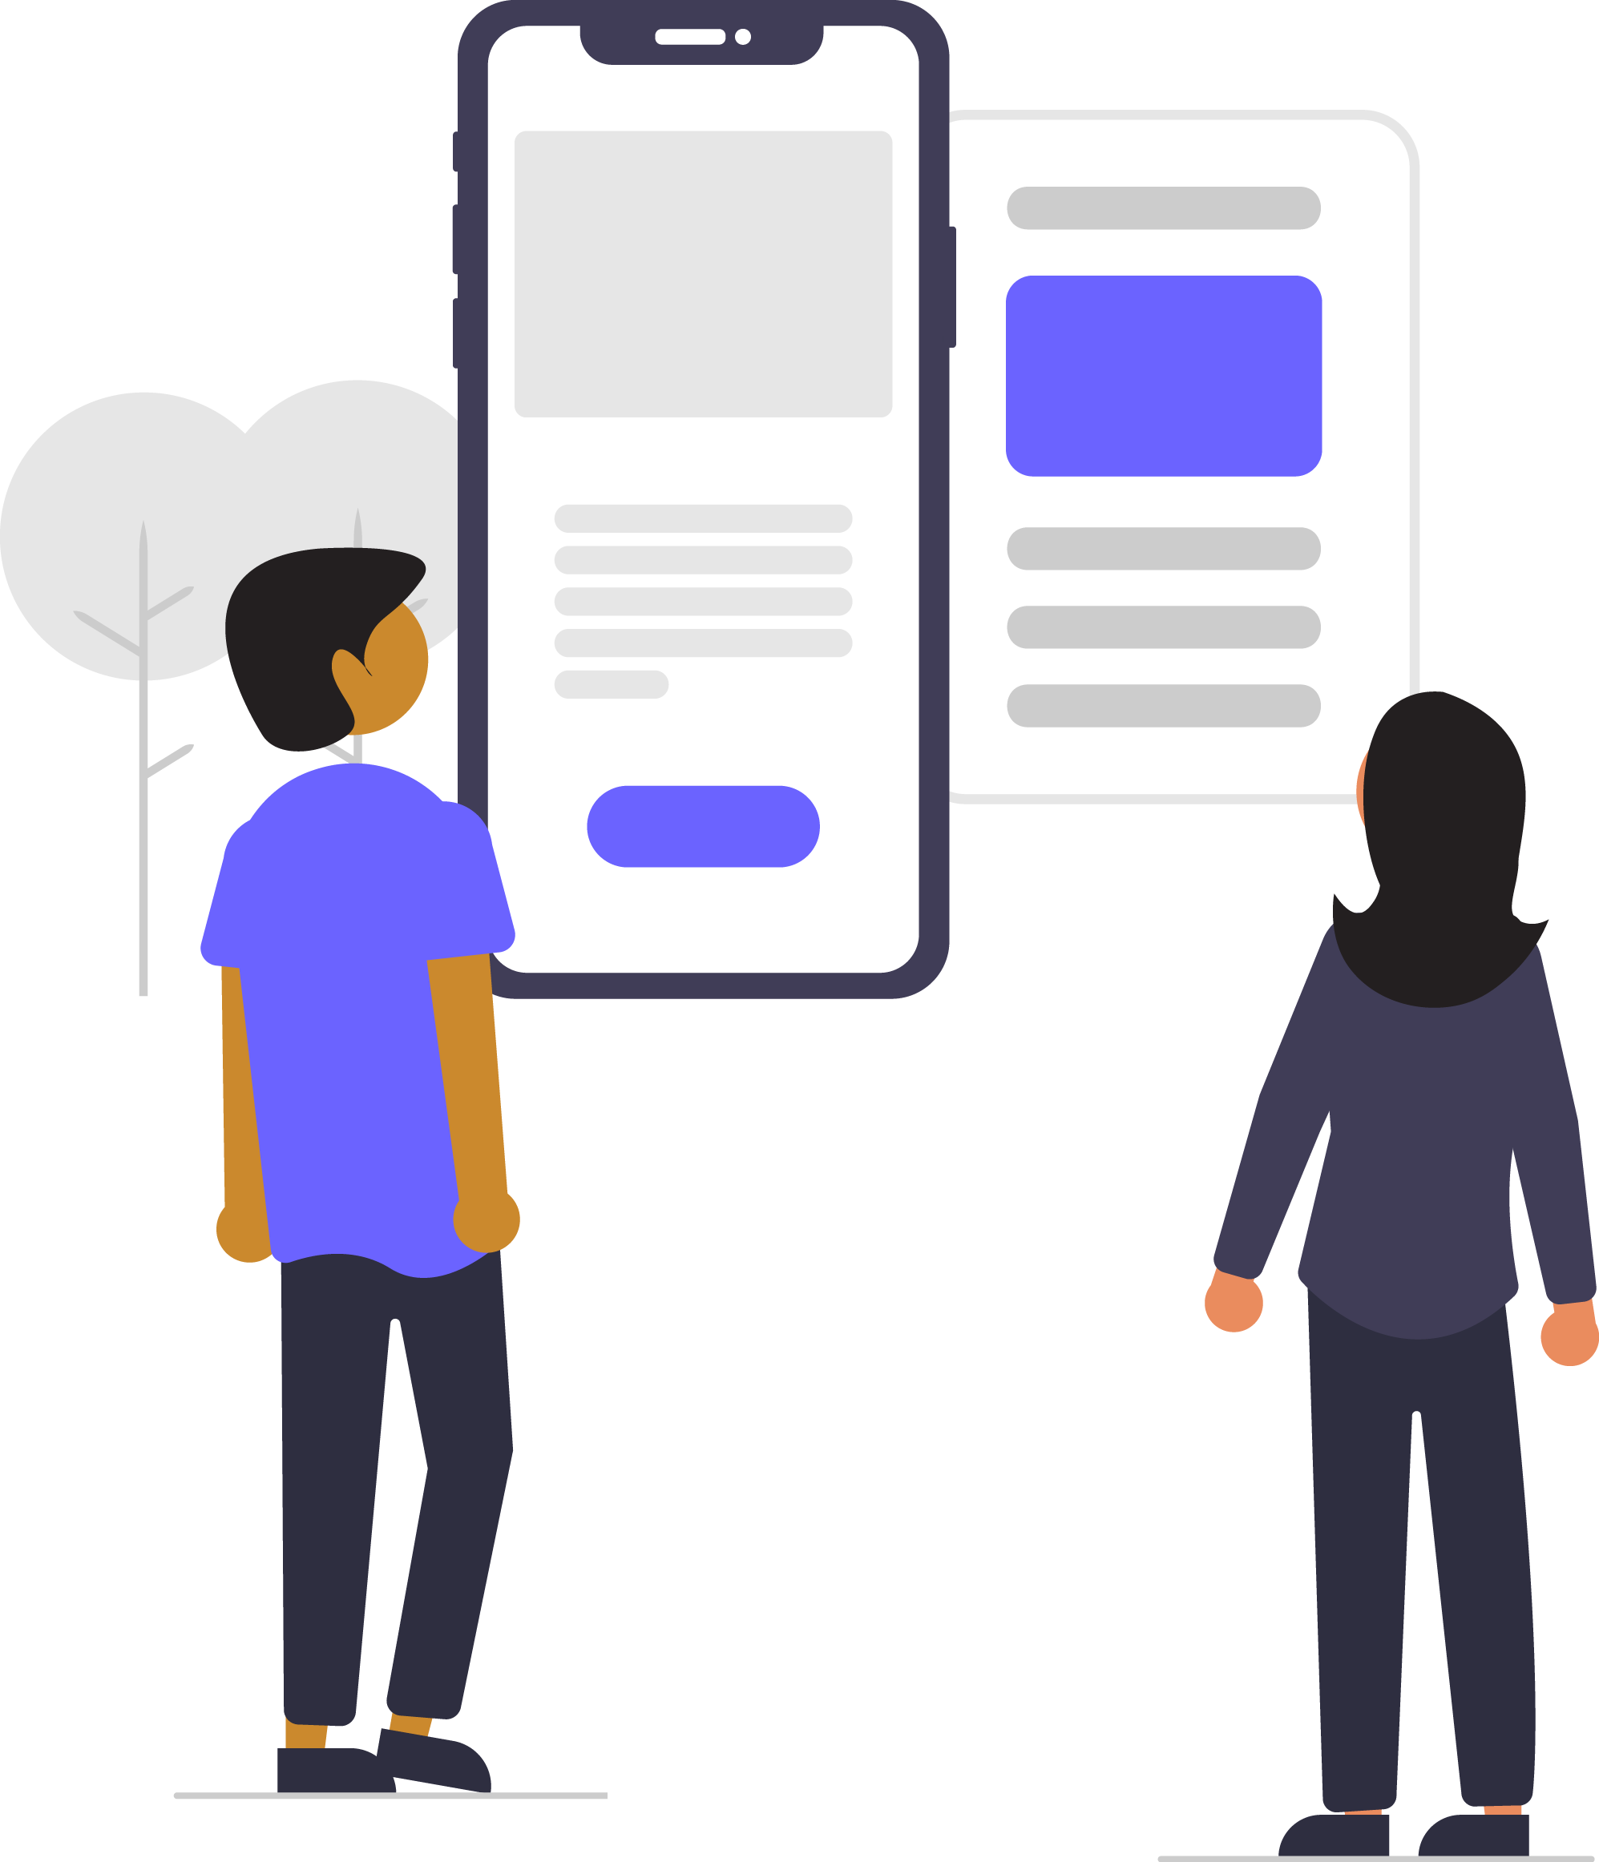
Digital skills for life
Classroom resources
Module 6
Online safety skills for life
Notes:
This is the first slide of the BBC Young Reporter classroom resources/lesson plans.
Module 6: Online safety skills for life
Duration: approximately 20 minutes
Resources needed: PPT and/or PDF
Audio-visual player if available.
Note to teacher: In this course we will learn some basic do’s and don’t’s to stay safe online. Your school may have other guidance for how students can protect themselves online. We recommend that discussion forms a bit part of this session, while being sensitive to people’s experiences which may be upsetting.

Slide 2
Objectives
For this lesson:
to learn how to stay safe online from harm
to learn how to protect your identity and be sure of others
to think about your media diet

Slide 3





Recap…
Notes:
Recapping - In lesson 1, we learned this top tip; pause before you share. In lesson 2, we learned to ask questions. In lesson 3, we learned about sources, and how to figure out who to trust. In lesson 4 we learned some tricks of the trade – click away to other sites to cross reference, and to look for the signs, like platform verification symbols. In the last lesson, we looked at some technical tools that can help you verify a story. In this lesson we are going to look at your personal online safety.

Slide 4

Notes:
Top Tip – remember fake news can come in all sorts of shapes, sizes and ways. It can be pictures, sound or text. It can come on through a social media app or you find it online.

Slide 5
Your digital life is your life…
What dangers do you face in life?
What do your parents tell you to look out for?
What do you do to stay safe from these dangers in your daily life?
What are you told by adults you should do to stay safe?
Now ask the same questions of your digital life?
Are some of the dangers and safety measures the same?
Notes:
Let’s look at what students do in their personal lives to stay safe and why. Dangers may be; cars/accidents, strangers, being bullied, robbed, losing things, dropping and breaking things, falling…. Talk through some of the things they do to stay safe – they may use a bag to put their things in, have PIN numbers, a locker at school, keys to the house, close the windows, don’t talk to strangers, don’t go out on their own, always tell their parents where they are, tell an adult if they have a problem, always get permission to go somewhere, have a system of contacting a parent when they are out, look both ways when crossing the road, walk away from an argument, have fire drills to practice leaving buildings, learn to swim…. etc.
Try to apply these to their digital lives. Do your parents always know where you are online? Do you put your personal things in a safe space online, do you get drawn into online arguments etc.

Slide 6
Your digital life is your life…
How many tips can you come up with to stay safe online?
What would you tell your granny? Your friend?
Notes:
Now move discussion on to students’ top tips. Can you build a list with a partner/small group/all together of top tips?

Slide 7
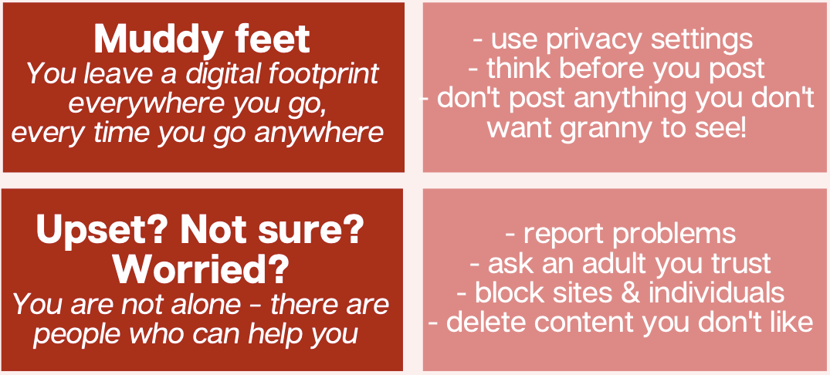

Notes:
Here are some tips you can talk through with your students.

Slide 8
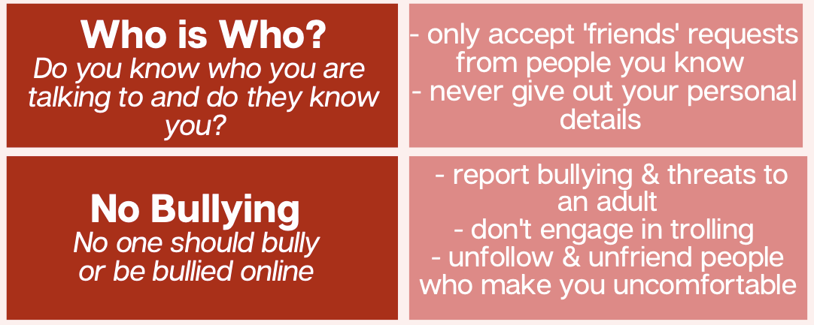
Notes:
Here are some tips from us…

Slide 9
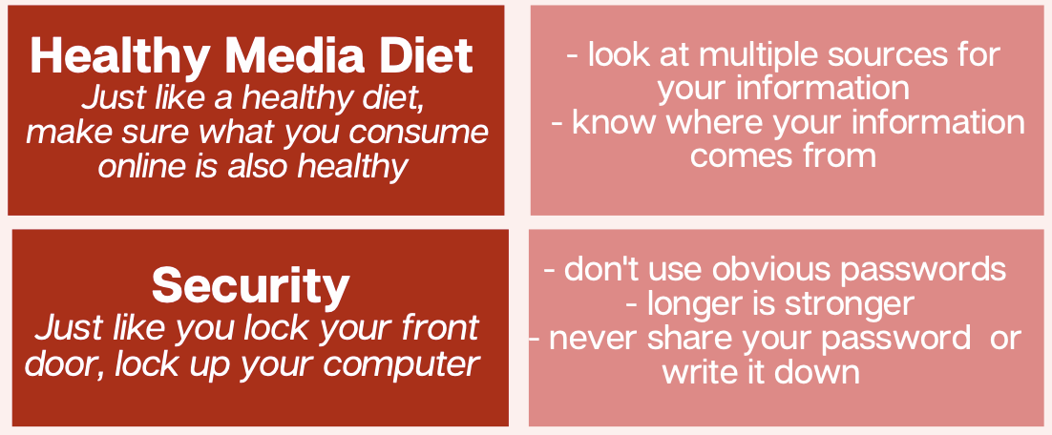
Notes:
Here are some tips from us…

Slide 10
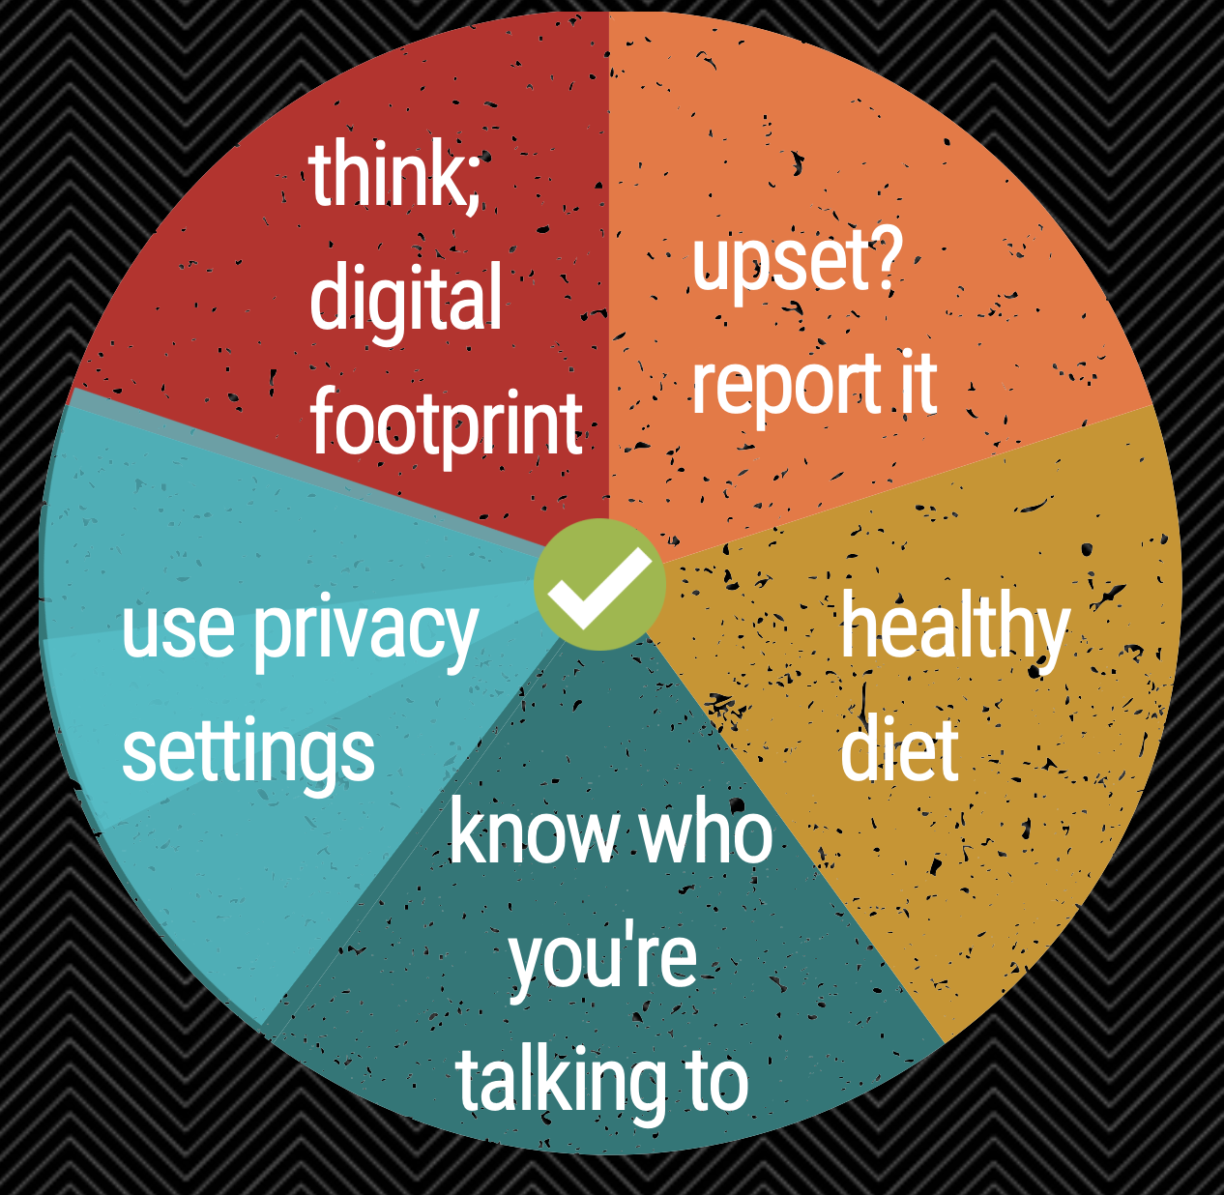
Notes:
To recap:

Slide 11
Notes:
Top Tip – remember fake news can come in all sorts of shapes, sizes and ways. It can be pictures, sound or text. It can come on through a social media app or you find it online.

Slide 12
End of module 6
Online safety skills for life
© BBC 2022
These workshops and slides are for educational and private study use only. They are not for resale or commercial and/or online distribution.
if you wish to use the workshops and slides for any other purpose, please contact marie.helly@bbc.co.uk
Notes:
This is the last slide of the BBC Young Reporter classroom resources/lesson plans.
Module 5: Tricks of the Trade
Duration: approximately 20 minutes
Resources needed: PPT and/or PDF
Audio-visual player if available.

