Slide 1



Digital skills for life
Classroom resources
Module 4
Tricks of the trade
Notes:
This is the first slide of the BBC Young Reporter classroom resources/lesson plans.
Module 4: Tricks of the Trade
Duration: approximately 20 minutes
Resources needed: PPT and/or PDF
Audio-visual player if available.

Slide 2
Objectives
For this lesson:
To learn some skills that fact checkers use to help to spot ‘fake news’
To apply these skills to real life examples

Slide 3



Recap…
Notes:
Recapping - In lesson 1, we learned this top tip; pause before you share. In lesson 2, we learned to ask questions. In the last lesson, lesson 3, we learned about sources, and that is was important to know your source and to work out whether you can trust them.
In this lesson, we are going to look at some tricks that fact checkers use to verify a story.

Slide 4

This lesson’s top tip is
Notes:
So the top tip in this lesson is to click away and to look for the signs. Let’s find out what this means.

Slide 5
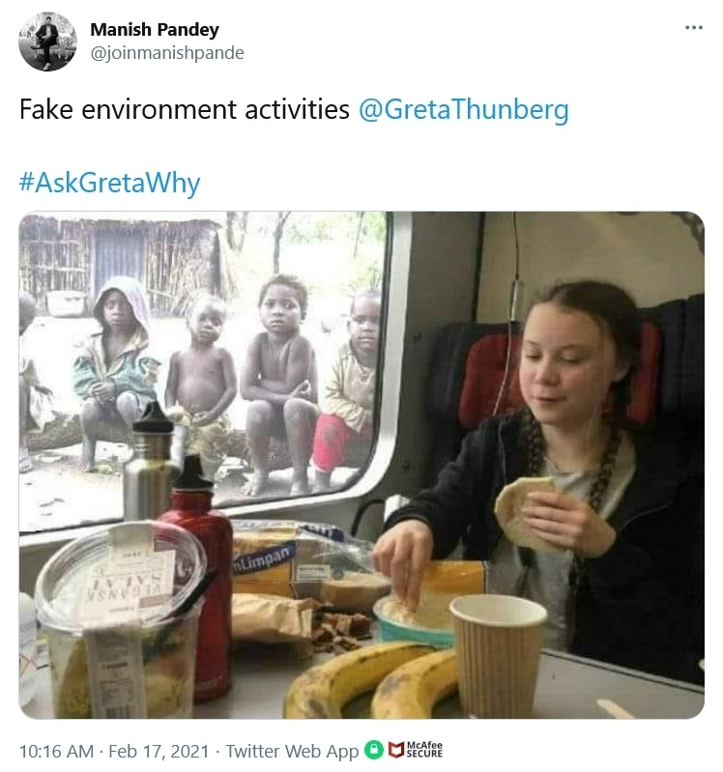
Did environment activist Greta Thunberg have food as poor children looked on?
Notes:
Let’s start with this picture and use those tips to decide if you think this picture is real or not – present the slide to the students.
What do they think? What tools have they learned previously that might help them? Click to the next slide for ideas.

Slide 6
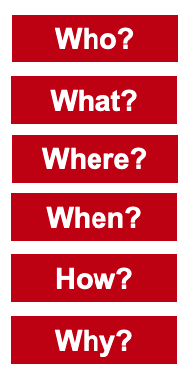
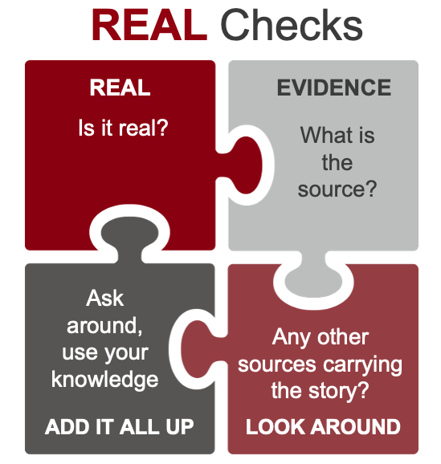
Notes:
What do they think? What tools have they learned previously that might help them?
They could pause before they share
They could use the REAL or journalists’ questions
They could ask if it’s ‘too good to be true’ – too funny to be true? To extraordinary to be true?

Slide 7
Click Away
The fact checker’s trick:
Sometimes, all it takes to discover if a post is real of fake
– is to click away.
Notes:
‘Click Away’ is what you do when you are looking at a probable piece of misinformation, that needs verification. You ‘Click Away’ from the information, and look for evidence, or the lack of it, from other sources. Rather than reading the whole article to the bottom, or trying to guess, clicking away, and searching for the story, headline or part of the story is all you need.

Slide 8
Click Away might involve:
text search on Google, Bing, Yahoo or other
picture search
going to another (trusted) news provider’s website
going to a website of expertise
the research methods you use eg in school
Notes:
Stress on the importance of Text Search using a search engine. It can be Google but it does not have to be.
Typing in words is easy – you do not have to be able to ‘reverse image search’. Try different combinations of words. (which we will look at in a later workshop)
Remember that putting “” around words means you are telling the search engine the words must appear together, as this phrase

Slide 9
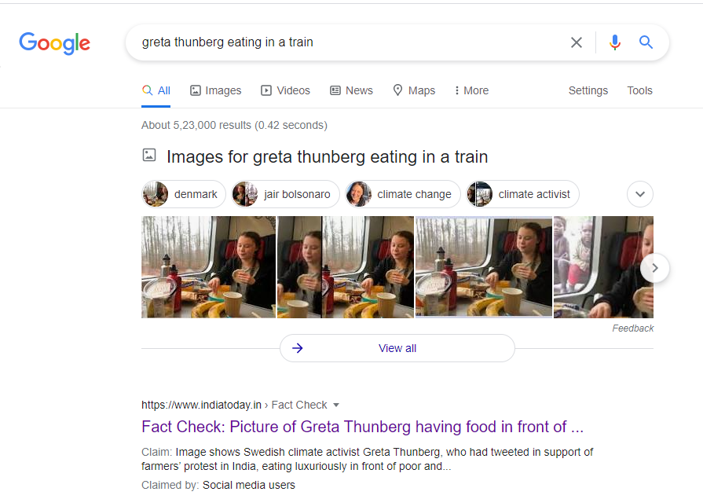
Search:
“Greta Thunberg eating in train”
Notes:
Let’s work through this idea of clicking away… here with the Greta picture, you could click away from the picture to google and search for this key phrase

Slide 10
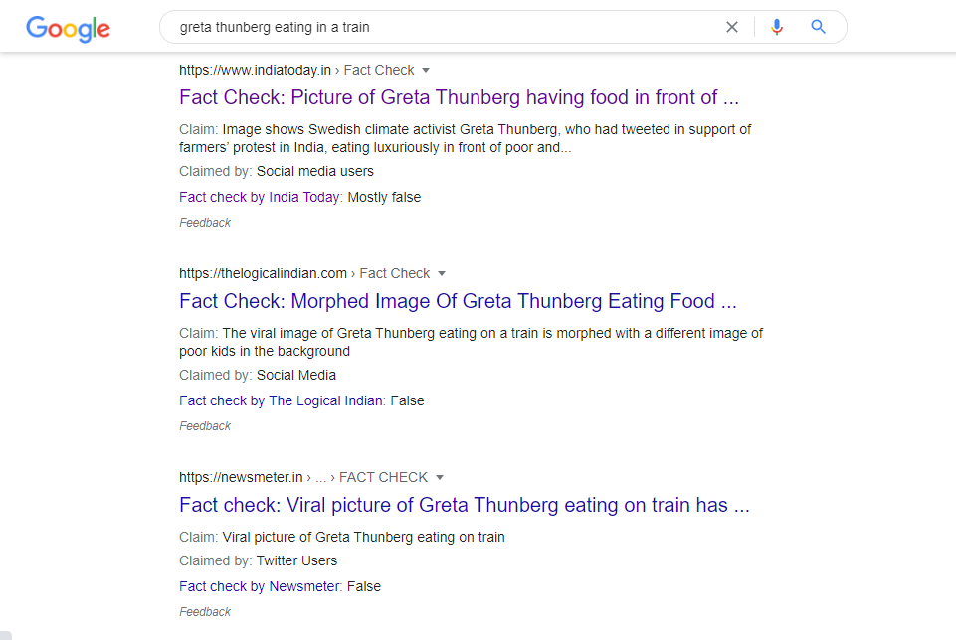
Search:
“Greta Thunberg eating in train”
Notes:
These are the results you get. There’s enough information from the results of your search to suggest that the original picture may not be accurate

Slide 11

Notes:
Now we have a new top tip… clicking away is like being a detective, see what you can find! Now it’s your students’ turn.

Slide 12
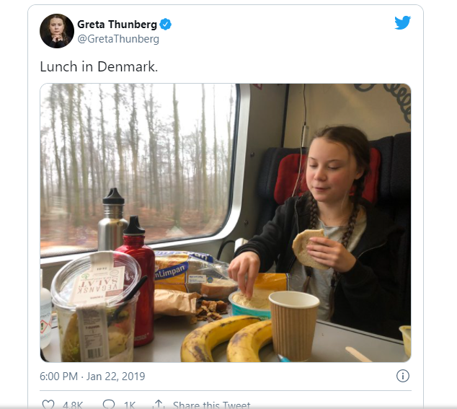
This is the original image.
Notes:
Provide this image as an attachment to the group.
Google Search gives you the result on Page 6 – tell the group to be diligent and adamant
An AFP Fact Check article will give the result

Slide 13
Look for the ‘signs’
The social media junkie’s tricks:
Notes:
Social media junkies can quickly get good at seeing signs of something being wrong. Here’s some things for you to look out for.

Slide 14
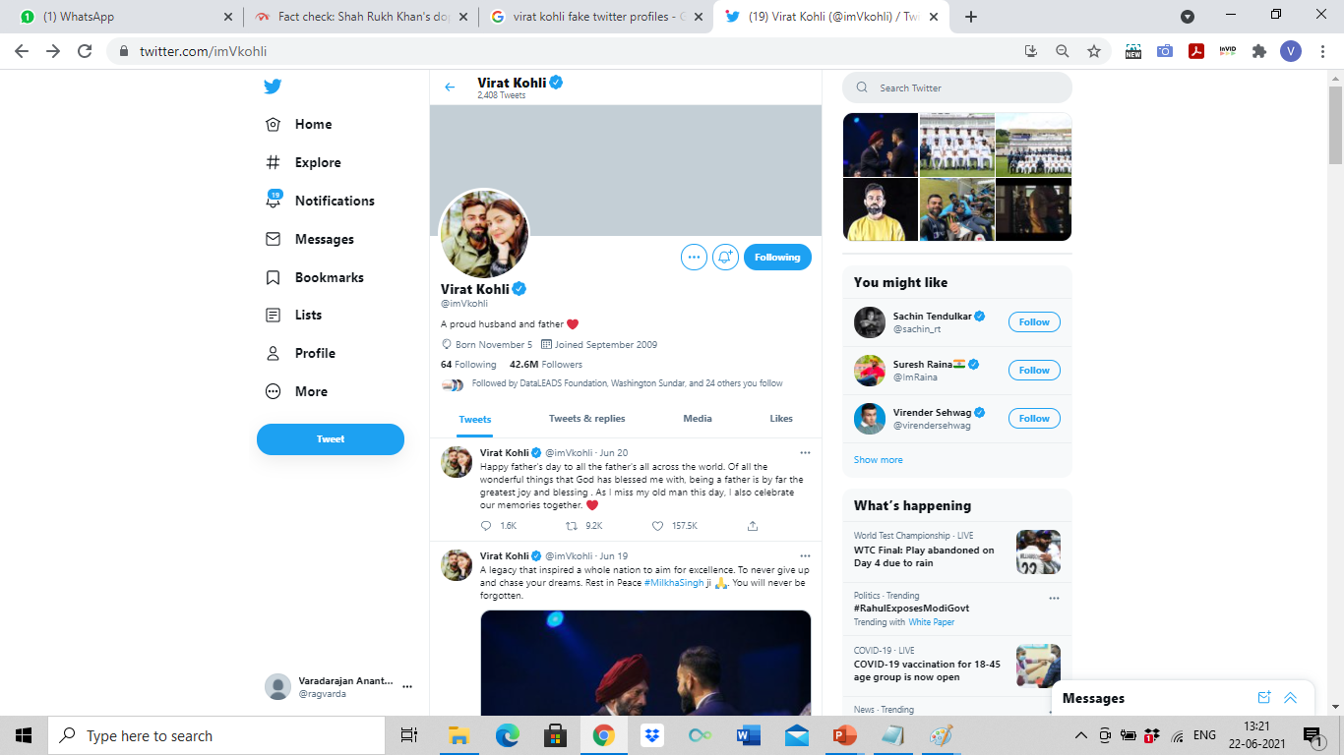
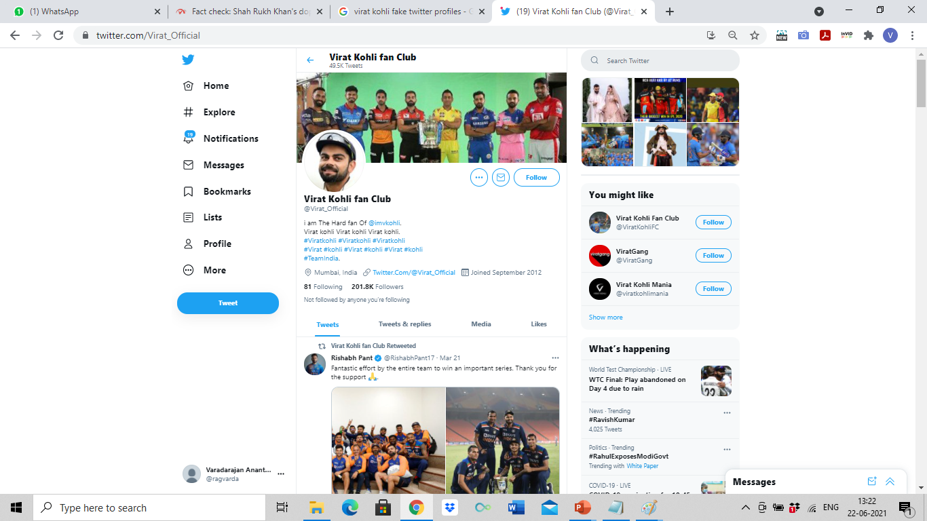
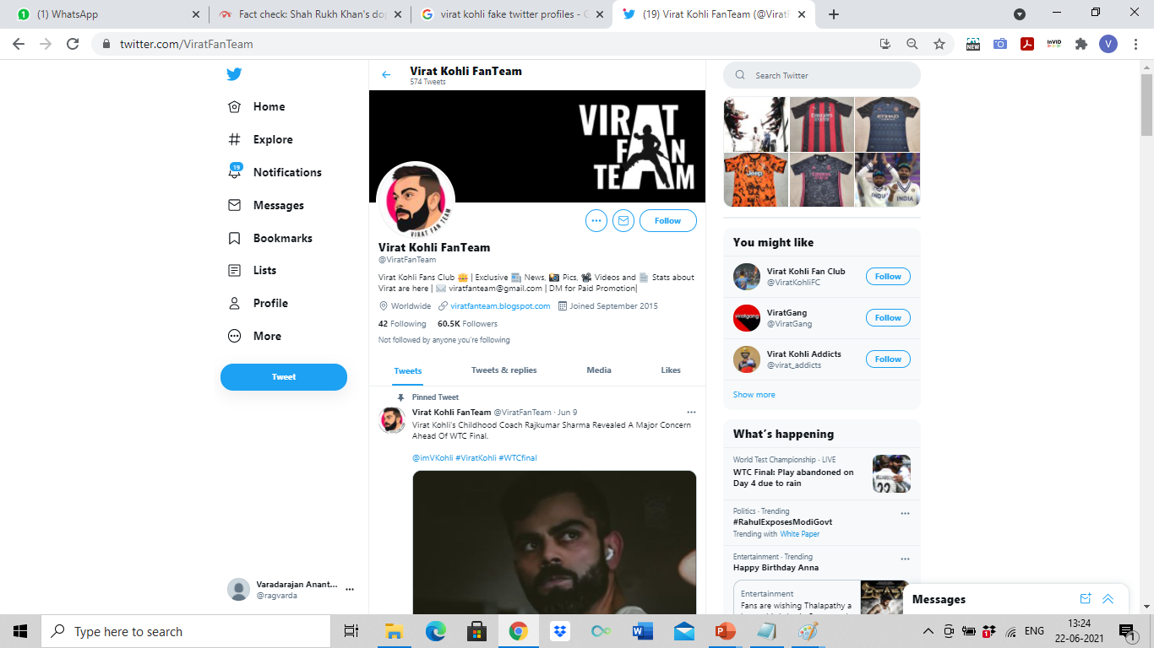
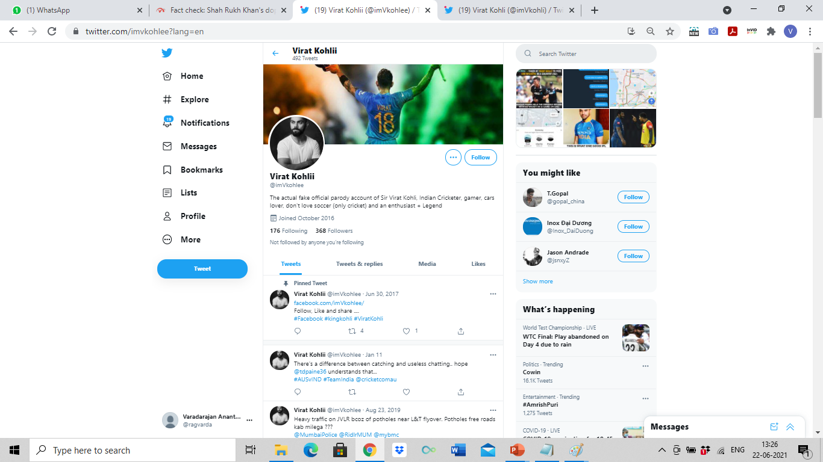
Can the real Virat Kohli, please
stand up?

Slide 15





Notes:
There are other signs and symbols that you could look for to see if an account really does belong to the person it says.
- Some platforms have a verification method – for Twitter it’s the blue tick which tells you this is the authentic account.
Does the social media account link to another site that you can be sure of eg their own website?
When did the person join, does this make sense?
How many people are they following and how many are following them? If you click on who they are following, do the people who find there make sense?

Slide 16
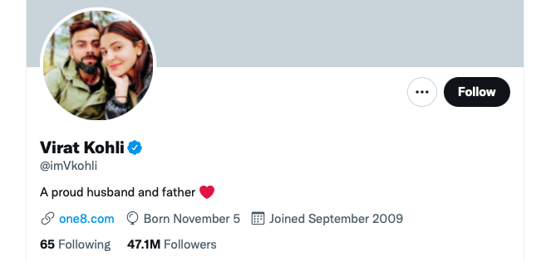
Notes:
This is Virat Kohli’s account.

Slide 17
This lesson’s top tip is
Notes:
Let’s recap – now we know what this means. We can click away from a page to discover more, and we can look for tell-tale signs!

Slide 18
End of module 4
Tricks of the trade
© BBC 2022
These workshops and slides are for educational and private study use only. They are not for resale or commercial and/or online distribution.
if you wish to use the workshops and slides for any other purpose, please contact marie.helly@bbc.co.uk
Notes:
This is the last slide of the BBC Young Reporter classroom resources/lesson plans.
Module 4: Tricks of the Trade
Duration: approximately 20 minutes
Resources needed: PPT and/or PDF
Audio-visual player if available.

