Slide 1


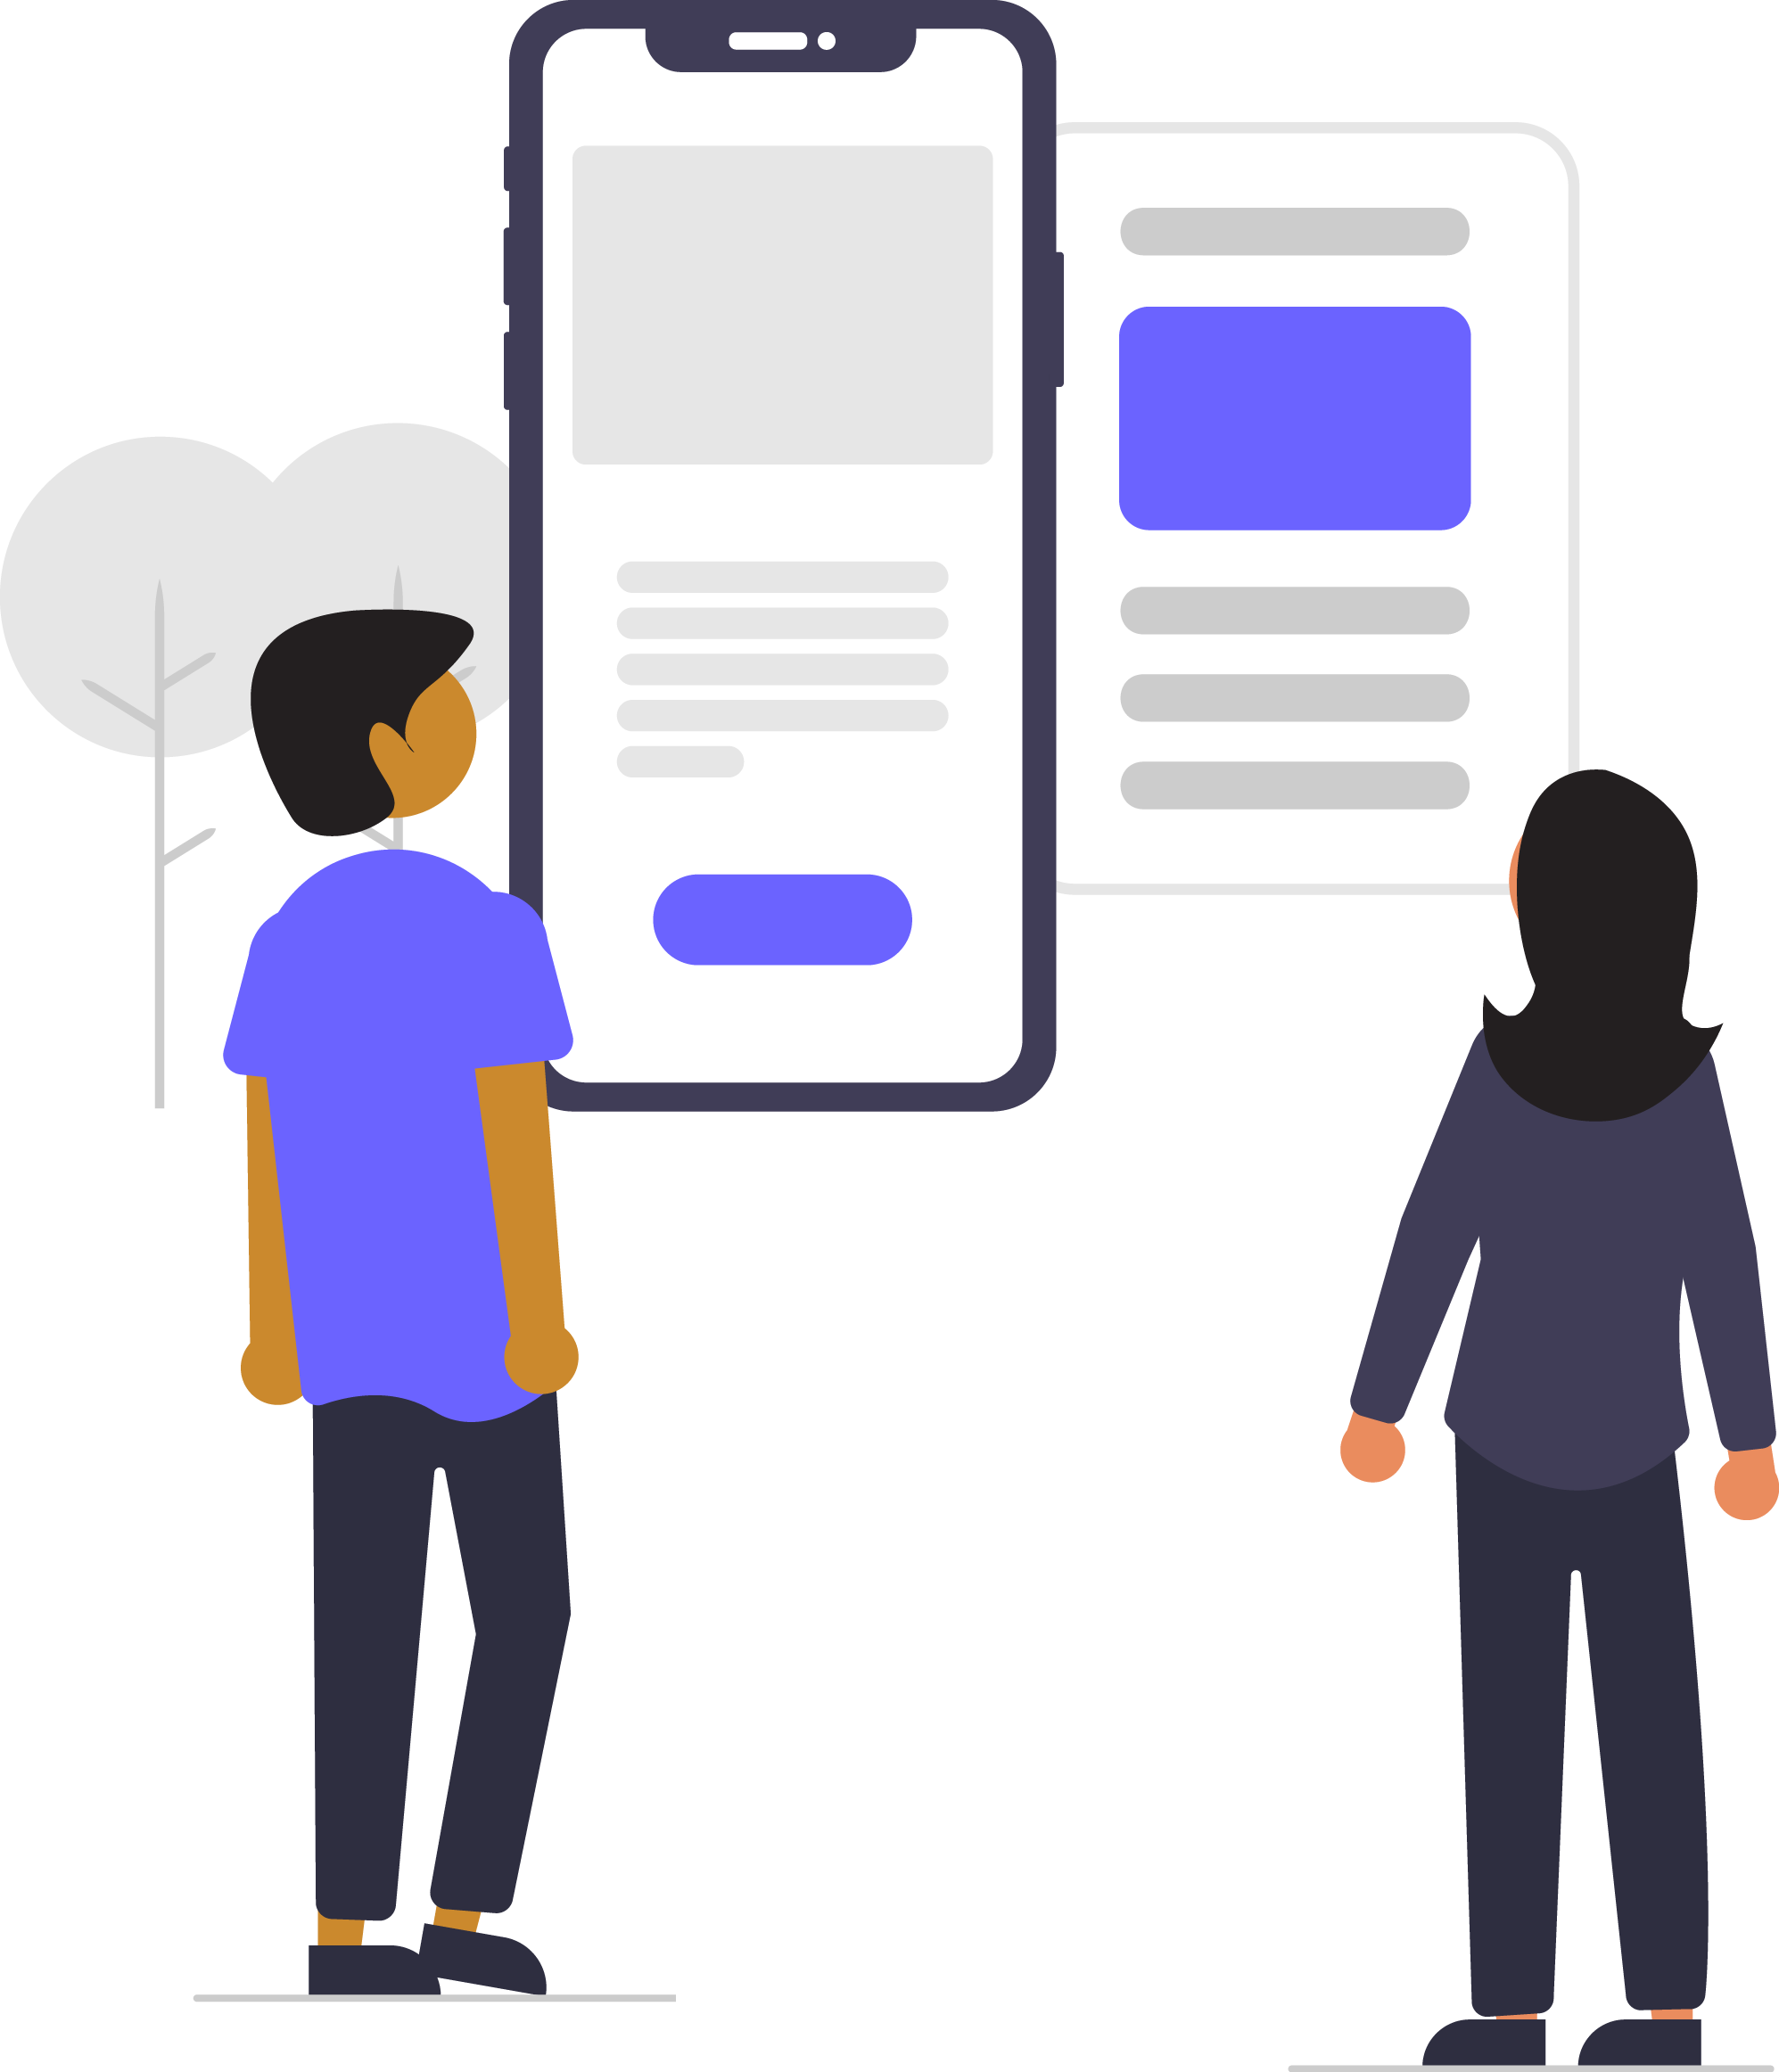
Digital Skills for Life
Classroom Resources
Module 2
Tools to check ‘fake news’
Notes:
This is the first slide of the BBC Young Reporter classroom resources/lesson plans.
Module 3: Tools to check ‘Fake News’
Duration: approximately 20 minutes
Resources needed: PPT and/or PDF
Audio-visual player if available.

Slide 2
Objectives
For this lesson: REAL checks & journalists’ questions
Learn to ask useful questions
Gain skills to check stories & spot and if you are being misled
Understand how these skills can be applied to all kinds of information
Notes:
In this lesson you will teach the students a ‘checklist’ method of verifying information – REAL checks – and also the kinds of questions that journalists ask to verify information.

Slide 3
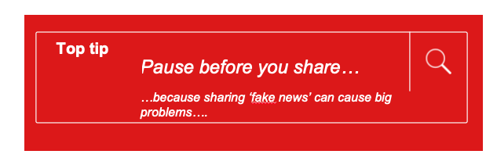
Recap….
Notes:
Top Tip – Last time we learned this top tip; pause before you share.
In this lesson, we are going to learn what you can do, once you’ve paused, to help spot if something is real or not real.

Slide 4

This lesson’s top tip is
Notes:
The top tip of this lesson is to ask questions; and your students will learn some techniques to do this.

Slide 5

REAL checks
REAL
EVIDENCE
Is it real?
What is the evidence?
Ask around, use your knowledge
Is any other source carrying the story?
ADD IT ALL UP
LOOK AROUND
Notes:
This diagram shows the REAL checks. It’s an easy to remember checklist that can help you quickly check to see if you think a piece of content is real/true/accurate or not.
Using the word ‘REAL’ prompts you to ask a series of questions about the content in question. Let’s take a closer look.

Slide 6
The REAL checks – four steps
Real: “Is this real?”
Evidence: Look at the evidence in front of you - the source, author, publication, web address, date & time, pictures, text, names
Ask & Add it all up: Can you ask someone like a teacher or parent? Does it add up with what you already know or can find out?
Look around: Check other sources to see if they are carrying the same story/information
Notes:
SCRIPT
These are the checks we have been doing…. [
Read through slide
All these checks help you build a picture, like putting a puzzle together, to help you decide if what you were seeing and reading was real, or not.
And of course, if you look at each of those steps you can see that you have spelt out the word REAL, to help you remember your check list.

Slide 7
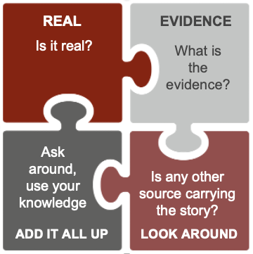
A message arrives on
What’s App from your cousin:
REAL
Is it real?
My friend’s dad is a doctor – he says 2 drops of lemon juice in your nose every day can prevent Coronavirus. His dad has been doing this for 10 years and says it works.
Ask around, use your knowledge
Is any other source carrying the story?
ADD IT ALL UP
LOOK AROUND
Notes:
Let’s do a scenario; A message arrives on your What’s App from your cousin. Read the message. Discuss.
Go through each of the letters in the REAL square, asking that question of the story. If you have time and resources, you could ask the students to go online and do some of these steps, like ‘Look Around’.
Eg. Could this be real? Does it sound too good to be true?
What is the evidence for this? What evidence is the person who wrote this or sent this providing? Who is the friend? And the dad? Look at the date reference – trying it for 10 years?
Ask a teacher or a parent – what do they say? From my knowledge of curing illness, could this be possible? Does it add up with what we know about coronavirus? 10 years ago there was no Covid 19.
Look around the internet – who else is carrying the story? Who else has a story about lemon drops? Do any health sites have this story?

Slide 8
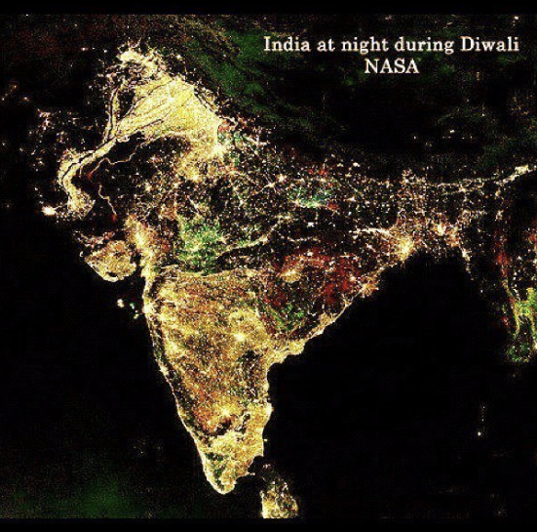
You see this photo on a website
REAL
Is it real?
Ask around, use your knowledge
Is any other source carrying the story?
ADD IT ALL UP
LOOK AROUND
Notes:
In this scenario imagine you have come across this photo on a website.
Go through each of the letters in the REAL square, asking that question of the story. If you have time and resources, you could ask the students to go online and do some of these steps, like ‘Look Around’.
Eg. Could this be real? Does it sound too good to be true?
What is the evidence for this? What kind of evidence would you look for?
Ask a teacher or a parent – what do they say? Have you heard of this photo before?
Look around the internet – who else has this photo?
This photo is not real. It goes viral almost every year at Diwali. It has been altered to make it look this way.

Slide 9
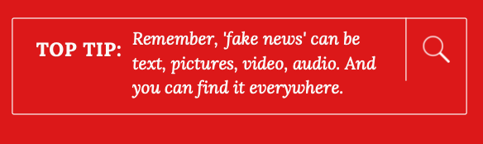

Remember…
you can use the ‘REAL’ checklist
to help you decide if a story is real or not
Notes:
Remember then … – fake news can come in all sorts of shapes, sizes and ways. It can be pictures, sound or text. It can come on through a social media app or you find it online. Remember you can use the REAL checks to help you spot if something is real or not real.

Slide 10


The journalist’s questions
Who?
Who wrote it? Who published it? Who sent it?
Who else has this story?
What?
What is the story? What is the evidence?
What is the motive?
Where?
Where else is this information? Where else have I seen this story? Where else does this photo appear?
When?
When did this happen? When was it written? When was the photo taken? When did I receive it?
How?
How does it want me to feel or think? How does the author know?
Why?
Why have I been sent it? Why has it been written?
Notes:
Another set of questions you can ask are the journalist's questions. These are taught to journalists all over the world and are a reminder of the different types of questions to ask. There are 6 questions that can be a helpful tool to check a story or piece of information and they are; who what where when how and why. Using these words and pushing yourself to form a question using this words, is a good way to get to the bottom of the story.

Slide 11
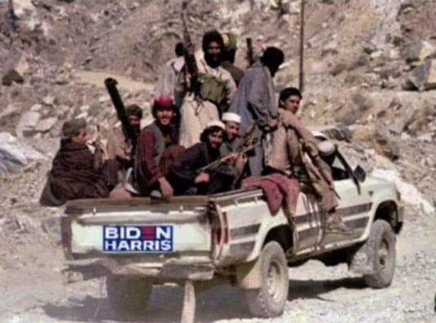
The journalist’s questions
Who?
What?
Where?
When?
How?
Why?
Notes:
Let’s try and use these questions on this photo that went viral in August 2021. It shows the a truck with Taliban fighters on it, in Afghanistan, and on their truck is has a Biden-Harris sign, the Presidential candidates for the Democratic Party in the 2020 election.
Try exploring this photo using questions only, and without knowing anything about it; what questions do students come up with if they are told nothing at all about the photo. What do they think they need or want to know? This is supposed to be a photo of the Taliban in Afghanistan, with a Biden-Harris election campaign sticker on their car. The photo is fake, in that the US election sticker has been photo shopped in. You can ask the students if they think the photo is real or not, but the important part of the exercise is to ask questions, to practice asking questions. Here are some ideas for questions:
Who has posted this picture? Who are the people in the truck? Who would put a sticker like that on their vehicle?
What are the people in the truck doing? What are they holding? What would they want with such a sticker?
Where are these people going? Where was this photo taken? Where was it probably not taken? Where might they have got the sticker from?
When was this sent to me? When did this go viral? When did the Biden-Harris election happen?
How would a US election stick have made it to this vehicle? How do the men in the truck know someone is taking a picture of them?
Why are the men holding guns? Why would they have a sticker? Why would someone want to take this photo?

Slide 12
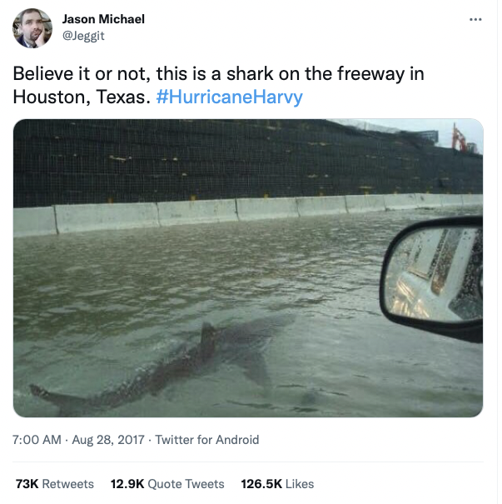
The journalist’s questions
Who?
What?
Where?
When?
How?
Why?
Notes:
Note to teacher: Whenever there is a big flood, especially on the east coast USA, pictures of sharks in the water invariably reappear. It’s a recurring theme.
Let’s try and use these questions on this tweet that went viral in August 2017 on twitter. Try exploring this photo using questions only, and without knowing anything more about it; what questions do students come up with if they are told nothing at all about the photo or tweet. What do they think they need or want to know? This is supposed to be a photo of a shark in the water following a huge hurricane on the east coast of the US. The photo is fake, it has been doctored. Again, you can ask the students if they think the photo is real or not, but the important part of the exercise is to ask questions, to practice asking questions. Here are some ideas for questions:
Who has posted this picture? Who took this picture?
What is the person seeing? What else can you see? What does the person who took this photo want me to feel?
Where was this photo taken? Where was it probably not taken?
When was this sent to me? When did this go viral?
How would a shark have ended up in the water like this?
Why would someone want to take this photo?

Slide 13
Remember…
you can use the journalists’ questions
to help you decide if a story is real or not
Notes:
Remember then, fake news can come in all sorts of shapes, sizes and ways. It can be pictures, sound or text. It can come on through a social media app or you find it online. Remember you can use the journalists’ questions to help you spot if something is real or not real.

Slide 14

This lesson’s top tip is
WATCH THIS FILM TO CONSOLIDATE YOUR LEARNING
Checking the Story
https://bbc.com/beyondfakenews/checking-the-story/
Notes:
Top Tip – so to recap, this lesson’s top tip is to ask questions, and we have two tools to help you; REAL checks and and the journalists’ questions.

Slide 15
End of module 2
Tools to check ‘fake news’
© BBC 2022
These workshops and slides are for educational and private study use only. They are not for resale or commercial and/or online distribution.
if you wish to use the workshops and slides for any other purpose, please contact marie.helly@bbc.co.uk
Notes:
This is the last slide of the BBC Young Reporter classroom resources/lesson plans.
Module 2: Tools to check ‘Fake News’
Duration: approximately 20 minutes

