Slide 1



Digital skills for life
Classroom resources
Module 1
Introduction to ‘Fake News’
Notes:
This is the first slide of the BBC Young Reporter classroom resources/lesson plans.
Module 1: Introduction to Fake News.
Duration: approximately 20 minutes.
Resources needed: PPT and/or PDF
Audio-visual player if available.

Slide 2
Objectives
For this lesson:
To understand what ‘fake news’ is, different types of ‘fake news’, who makes it and why
Start to build some top tips for students
Notes:
These are the objectives of this lesson.

Slide 3
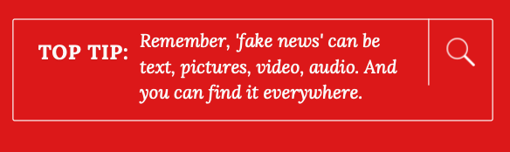


Pause before you share…
…in this lesson you’ll find out what ‘fake news
is & why sharing ‘fake news’ can cause big problems….
Notes:
Throughout the PPTs you will find lots of top tips to share with your students. They are all connected to the learning.

Slide 4
Quiz
Can you spot ‘fake news’?
Notes:
Let’s start with a quiz for you – do you think you can spot ‘fake news’?
In this section is a quiz, showing various photos and asking students if they think the image and/or the story behind the image is real or not real (true/false).
Ask the students to give “thumbs up” or “thumbs down” emojis on chat, or in a classroom. (thumbs up = real, thumbs down = not real)
Engage students in discussion as to why they this the images are real or not real before revealing the answers. This will set their thinking up for the rest of the session.

Slide 5
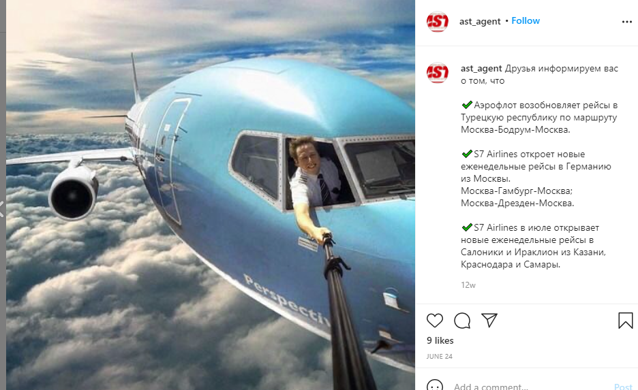


Did this pilot take a selfie out of the cockpit window during a flight?
Real or Fake
Notes:
Dis this pilot take a picture out of the window of his cockpit during a flight? Ask your class. Ask them to vote. If you think this is real (thumbs up) or not real (thumbs down)?
Discussion:
Why do you think it is real, or not real?
What clues are you looking for?
What could you do to check?

Slide 6
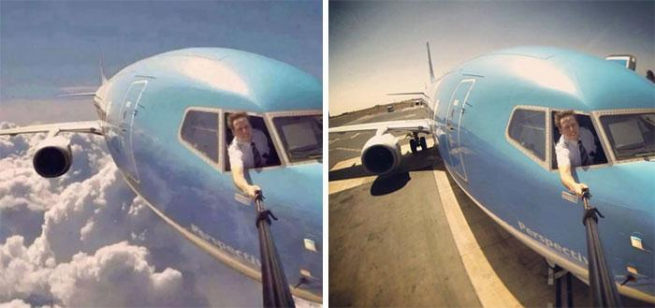
Fake. The photo was clicked before the flight had taken off
Notes:
This pilot has posted lots of photos of selfies with many different backgrounds, using a photo he took on the ground. They are all manipulated, many of them using this shot on the runway.

Slide 7
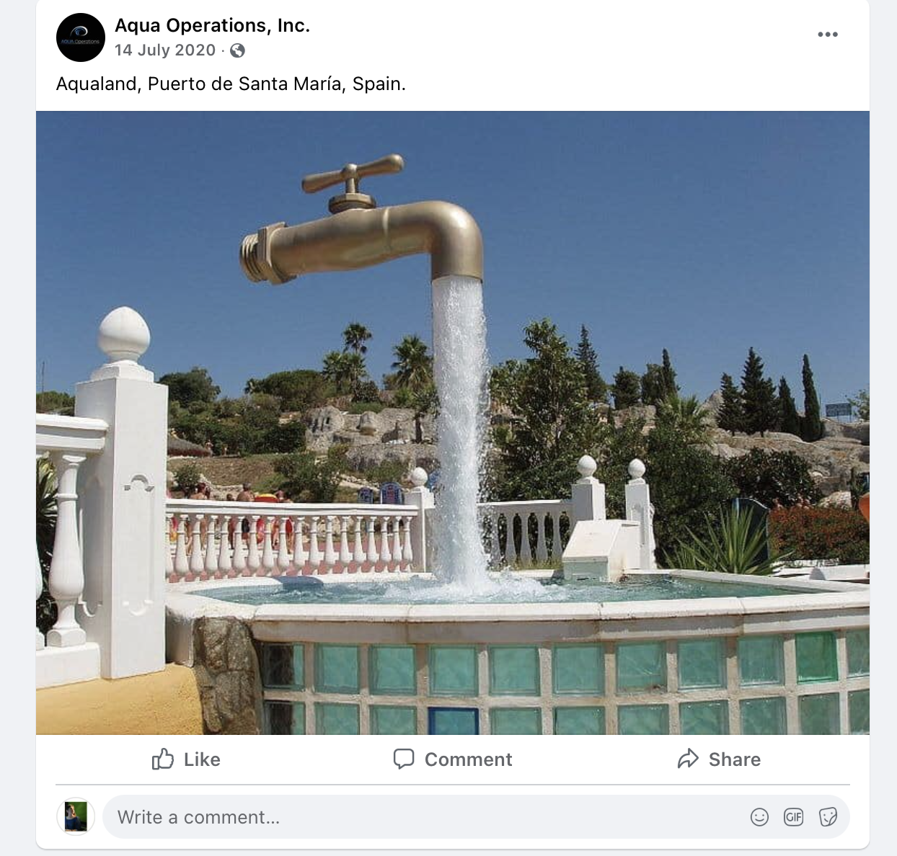
Is this a “Magic Tap” Fountain?
Real or Fake
Notes:
Do you think this is real (thumbs up) or not real (thumbs down)?
Discussion:
Why do you think it is real, or not real?
What clues are you looking for?
What could you do to check?

Slide 8
This “Magic Tap Fountain” is in Aqualand, Puerto de Santa Maria, Spain
Notes:
There are several giant floating tap fountains in Spain, Belgium, US, Canada and other parts of the world. This one is located at Aqualand, Puerto de Santa María, Spain.

Slide 9
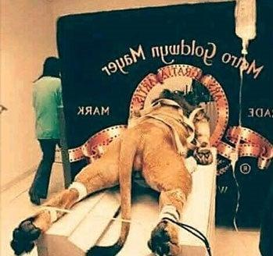
Is this how the roaring lion in the iconic MGM intro was filmed.
Real or Fake
Notes:
Do you think this is real (thumbs up) or not real (thumbs down)?
Discussion:
Why do you think it is real, or not real?
What clues are you looking for?
What could you do to check?

Slide 10
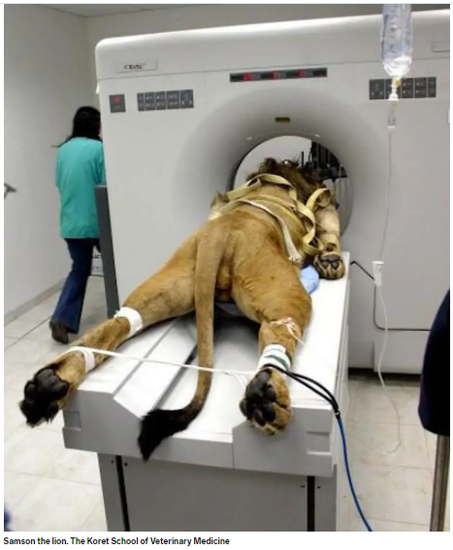
This is a real image of a sick lion in an Israeli zoo, who underwent a scan in 2005
Image from: The Koret School of Veterinary Medicine
Notes:
This is the real picture of a lion in a scanning machine, taken at a zoo in Israel in 2005. The image was altered to make it look like this is how the MGM ident was filmed.
https://www.snopes.com/fact-check/leo-the-lion-mgm-logo/
https://www.businessinsider.com.au/story-behind-the-lion-who-got-a-cat-scan-2015-10

Slide 11
What was your score?
Notes:
Note to teachers: the score does not really matter. The quiz is to get them thinking.
Discuss
What did this quiz make you think? Do you think you are good at spotting when something is real or not real (or fake)?
Would you call some of these pictures ‘fake news’? What do we mean by ‘fake news’?
Is ‘’fake news’ always a picture? What else can it be?
Has anyone seen another picture or photo they thought was not real?

Slide 12
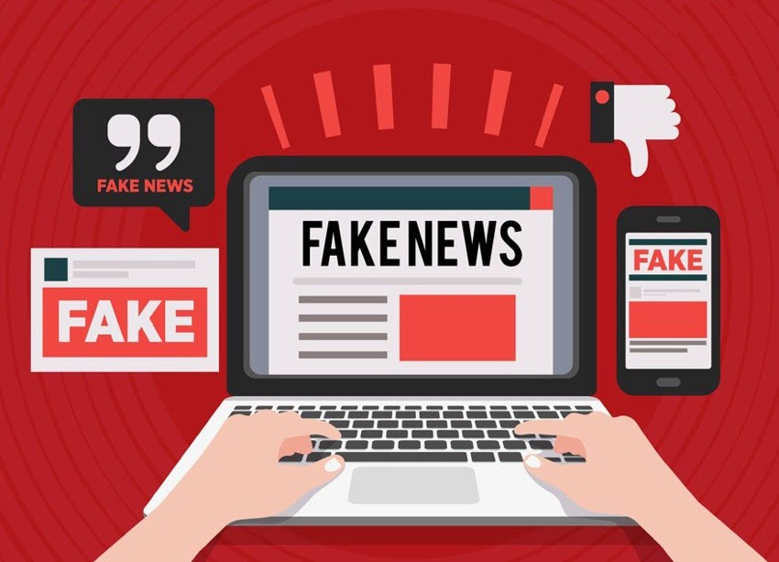
So what exactly is ‘fake news’?
Do you know what ‘fake news’ is?
Did you ever fall for ‘fake news’?
What did you do with it?
Notes:
Open discussion exercise: Encourage participants to expand on their answers. Also ask participants for their definition of ‘fake news’.

Slide 13
Misinformation
Misinformation – an umbrella term to describe
false, misleading or out of context material regardless of the motivation behind it.
It can also be described as bad information.
Notes:
Defining ‘fake news’ is not that easy. But broadly, the following terms are used and defined like this: Misinformation etc.

Slide 14
Disinformation
Disinformation - a deliberate attempt to mislead using material that the deceiver knows is untrue.
Designed to be widely shared
The purpose is often to persuade people to think
a certain way, vote a certain way, or to make money from advertising each time someone clicks on a story

Slide 15
‘Fake News’
‘Fake News’ – a colloquial term widely used
across many languages.
Politicians and activists have used the term as an
insult against their opponents or a way to dismiss stories or questions they don’t like or want to avoid, no matter whether they are factual or not.
Notes:
'fake news’ is a really useful term as so many people understand, broadly, what is meant by it. However, many people (for example among academics, educators and the media) are not comfortable with the word, as they say it lacks meaning, clarity, and has been devalued by over use, and as a foil to block or dodge engagement in topics they would rather avoid.

Slide 16
Misinformation can be
Text
Audio
Video
What have you seen?
Notes:
Discuss:
In our quiz, we only had photos that were ‘fake’ – or not fake. Is all fake news pictures? What else?
Misinformation can be text, audio, video …. It can be on a website, and email, what’s app, TV, radio, newspapers….
Ask the students what misinformation they have seen.

Slide 17








What’s the problem with ‘Fake News’?
Notes:
Discuss: what is the problem with fake pictures, or fake news? These images are to prompt ideas, but there are some very serious outcomes of fake news. Believing false information could leave you out of pocket, believing something that isn’t true, voting for something that isn’t what it claimed to be, or worse can lead to confusion, disruption even violence in a community or society.
Here are some discussion ideas for you that offer answers to what that problem is with ‘fake news’:
Believe something that isn’t true
You may act on a piece of information that is not real
Eg buy a product, vote, sign a petition
Feel confused, not sure what to believe
Can create panic, or fear
Can lead to unrest, even violence

Slide 18
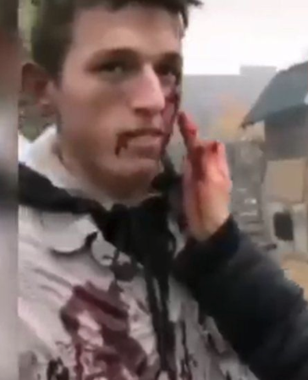
This image comes from a video shared on Facebook.
It shows a young man having fake blood applied to his face, suggesting that the victims of war in Ukraine were not injured civilians, but actors. And that the war itself was therefore a hoax.
Millions of people saw it.
But it is real or fake?
Notes:
This is a story which demonstrates a very serious side of ‘fake news’. Read the slide. Discuss what the students think. The answer is: The video was shot in the Ukraine, but it in fact comes from a 2020 TV series, and is footage shot behind the scenes. It is not from 2022 Feb/March.
Discuss with your class the impact of a fake news story like this. Could this story do damage? What are the implications – for people in Ukraine, for people in Russia, for people around the world.
It is a direct attack on the truth of what is happening in Ukraine; by suggesting these are actors, it sheds doubt on whether Russia invaded Ukraine at all. It also has the potential to sway public opinion away from sympathising with victims of war, and public opinion can impact government decisions on matters such as intervention and aid.

Slide 19
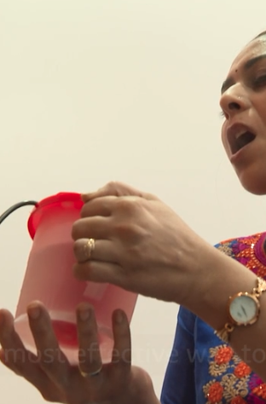
This image comes from a video shared mainly on What’s App.
The video is presented by a man from Gujarat who claims that breathing steam is the most effective way to prevent Coronavirus.
The video went viral.
But it is fake? – inhaling steam does not prevent Coronavirus.
Notes:
This is a story also demonstrates a serious side of ‘fake news’. Read the slide.
Discuss with the students if they think it was real or fake. Answer: It is not true that inhaling steam prevents Coronavirus. What impact could this have on people? Could such a story do any damage?
Discussion: Doctors are concerned that misleading information like this means that people might put themselves and others (including those who may be vulnerable) at risk of infection believing they are protecting themselves. If they believe this, what else are people believing? What advice are they not hearing?
Note to teachers: This story – and others like it – can be harmful because they ignore or downplay good, well-evidenced advice. This kind of disinformation encourages people to ignore good medical advice to prevent or treat disease. These kinds of stories are often associated with other narratives, like an anti-vax agenda.
During times of crisis – like a pandemic, or global event, or country-wide event, war – certain kinds of stories re-surface. They are harmful because they are untrue, they fail to provide real, useful, sometimes life saving information, and again they can be associated with other harmful narratives.

Slide 20
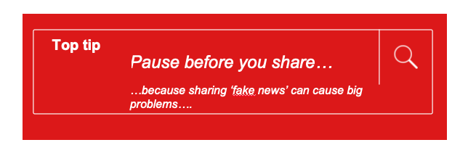
WATCH THIS FILM TO CONSOLIDATE YOUR LEARNING
What is fake news? (Hindi)
https://www.bbc.com/beyondfakenews/what-is-fake-news/
Notes:
Discuss this top tip. We have learned why it’s important to pause before you share. Misinformation is real, we can’t always spot it, and it can be harmful. So it’s a good idea to pause before you share.

Slide 21
End of module 1
Introduction to ‘Fake News’
© BBC 2022
These workshops and slides are for educational and private study use only. They are not for resale or commercial and/or online distribution.
if you wish to use the workshops and slides for any other purpose, please contact marie.helly@bbc.co.uk
Notes:
Ther

