Slide 1


Fact and Opinion
Teacher or Student-led assembly
Notes:
START
This slide marks the start of Assembly 4, Fact and Opinion. It’s an assembly that you can get your students to run, or it can be teacher led.
READ OUT:
SPOKEN: Today we will look at the different kinds of information.
In particular we will explore the difference between fact and opinion.

Slide 2

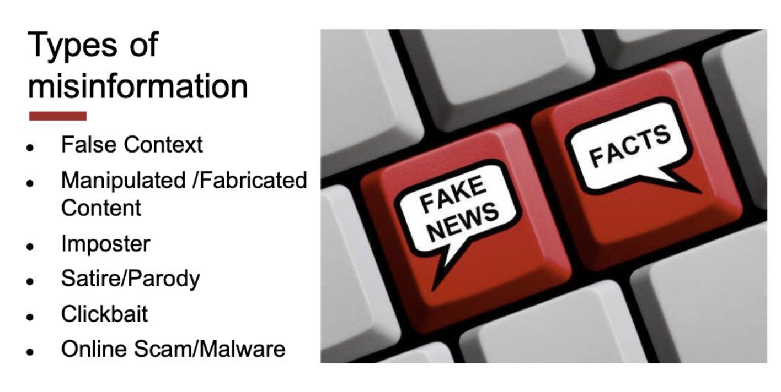
ADD IT ALL UP
Notes:
SPOKEN: There are lots of different types of misinformation; that is information which is not true or accurate or real.
SPOKEN: The types of misinformation are; read slide

Slide 3
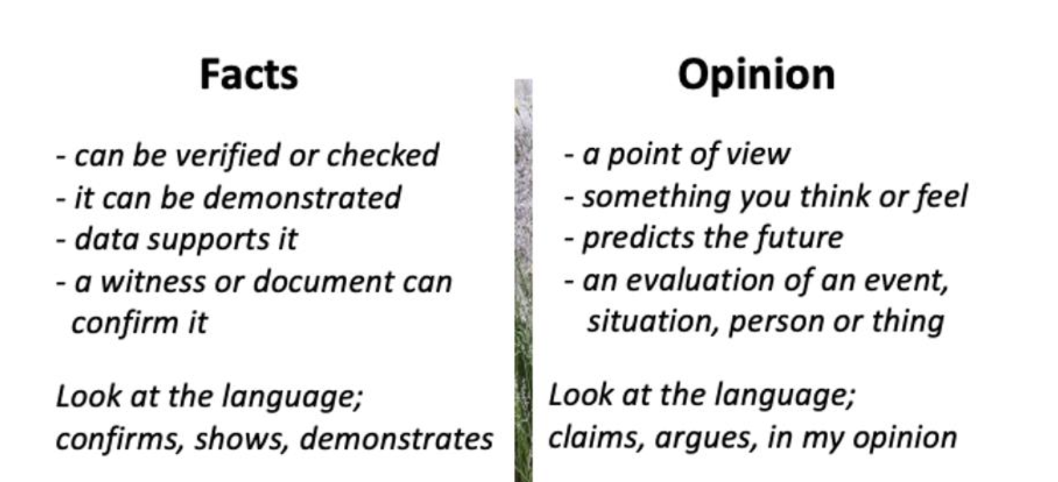
Notes:
SPOKEN: There are also different types of real and true news information; factual reports, analysis, explainers, opinion pieces.
SPOKEN: It’s important, even when looking at information that is reliable, to understand the difference between fact and opinion.
SPOKEN: A fact is…. (read slide)
SPOKEN: An opinion is …. (read slide)

Slide 4
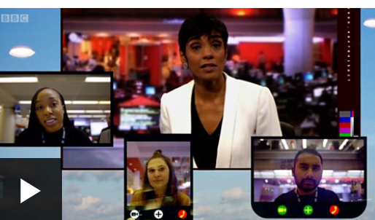
https://www.bbc.co.uk/bitesize/articles/zkfw7nb
Notes:
Here’s a video you can watch.

Slide 5
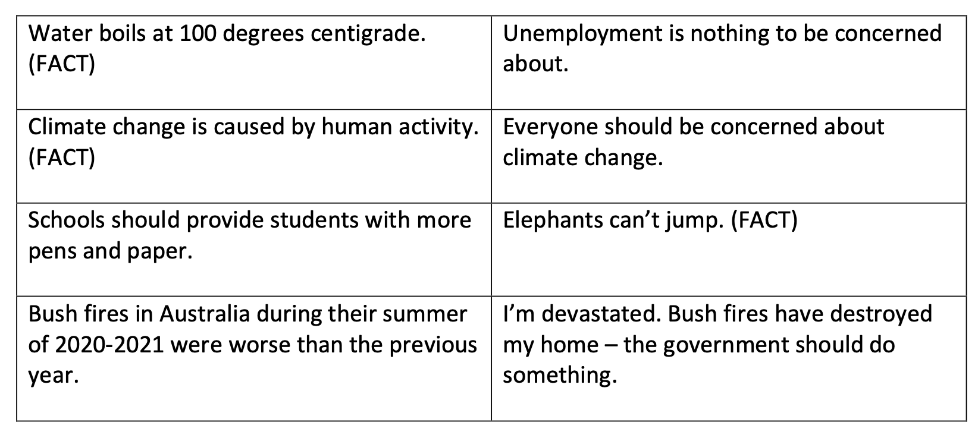

LOOK AROUND
Notes:
SPOKEN:
Let’s see if we can spot the difference. Which of these sentences is fact and which is opinion? You can set up teams, or play individually, and ask students to do different things (hands up/stand up) to show whether they think something is fact or opinion.
Water boils at 100 degrees centigrade is FACT
Climate change is cased by human activity is FACT
Elephants can’t jump is FACT
SPOKEN:
Why do you think it is important to know the difference between fact and opinion?
Let your classmates offer some answers.

Slide 6


Fact and Opinion
Notes:
SPOKEN: Both facts and opinion are important to understanding the news.
SPOKEN: Facts help us be certain of what has happened or is happening.
SPOKEN: Opinions can help us understand what it’s like for individuals affected by a story, an expert opinion can help us to understand complex stories, an economist’s opinion may help identify a solution.
SPOKEN: Together, both fact and opinion can help us understand the world better. But it’s important to notice which is which. Sometimes, facts can look like opinions when they are not.

Slide 7
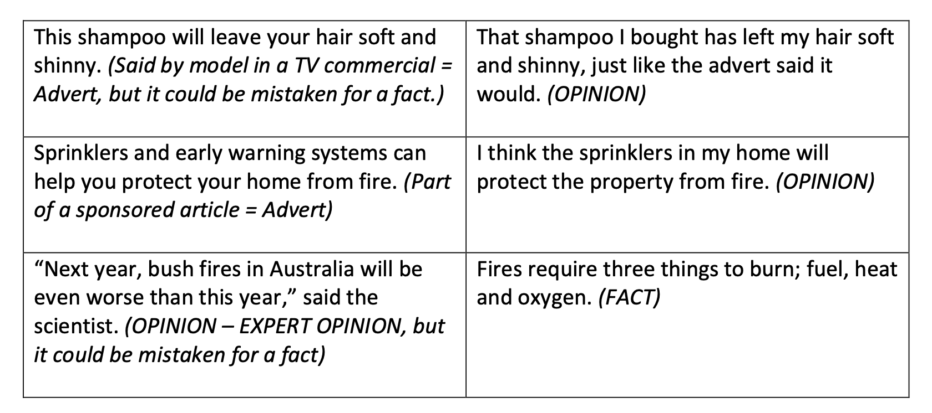


Notes:
SPOKEN: Sometimes statements look like facts but they are in fact adverts or marketing. .
SPOKEN: Let’s try the fact – opinion game again. This time, we will add in marketing so; is the statement fact, opinion or advertising/marketing. Play the game again asking each time whether it is fact, opinion or marketing.
This shampoo will leave your hair soft and shinny. Advert, but could be mistaken for fact.
That shampoo I bought has left my hair soft and shinny, just like the advert said it would. Opinion
Sprinklers are early warning systems can help you protect your home from fire. Advert, though it may be factually correct.
I think the sprinklers in my home will protect the property from fire. Opinion, if based on fact.
”Next year, bush fires in Australia will be even worse than this year,” said the scientist. Opinion – expert opinion, but it could be mistaken for a fact.
Fires require three things to burn; fuel, heat, oxygen. Fact.

Slide 8
Fact and Opinion
© BBC 2022
These workshops and slides are for educational and private study use only. They are not for resale or commercial and/or online distribution.
If you wish to use the workshops and slides for any other purpose, please contact marie.helly@bbc.co.uk
Notes:
SPOKEN: So remember; facts and opinion are always found in the news and information. They are both useful in helping us understand events.
SPOKEN: But remember, it’s important to know the difference between them so that we don’t mistake an opinion for fact.

