Slide 1


What do you see?
Notes:
START
This slide marks the start of What do you see? :Looking at pictures… You can use this slide as a holding slide while waiting to start.
Fake news – or disinformation or misinformation – can include pictures. In fact loads of pictures online or social media have been altered, and could be called ‘fake news’.

Slide 2

Notes:
What do you see? Two faces or a vase/candlestick?

Slide 3
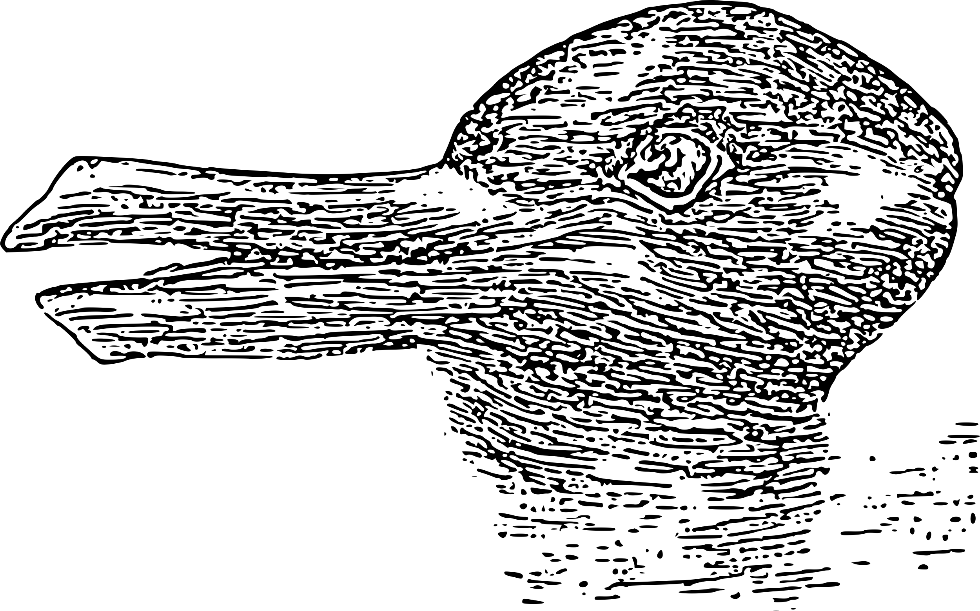
Notes:
What do you see? Duck or rabbit? Can you see both?

Slide 4

REAL checks
REAL
EVIDENCE
Is it real?
What is the source?
Ask around, use your knowledge
Any other sources carrying the story?
ADD IT ALL UP
LOOK AROUND
Notes:
These are the REAL checks. These questions can help us to spot fake pictures.
R = is it real?
E = Evidence, what evidence is there?
A = Ask questions, ask around and add it up
L = Look around, are there other sources carrying this story.

Slide 5
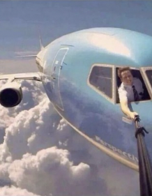
Notes:
Remember this photo – let’s do the REAL checks on it. [Students who have done the workshop will have seen this photo]
R = is it real? Could it be real? Have you ever known a pilot to open the window like this while flying? How could he hold the camera still? etc
E = Evidence, what evidence is there? What information has come with this story? Even simple things like a date or a name.
A = Ask questions, ask around and add it up. What do other people think?
L = Look around, are there other sources carrying this story. Can you find this photo anywhere else? What are other sources saying about it?

Slide 6
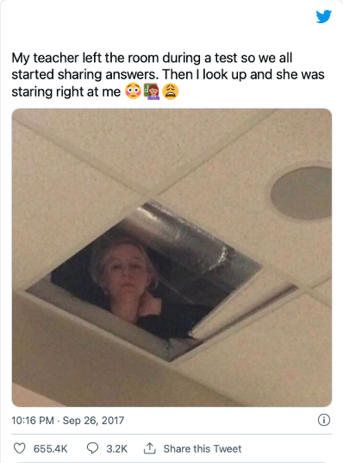
Notes:
What about this picture and comment in this tweet? Do you believe it?
Can you do the REAL checks on it?
Buzzfeed investigated and it’s not true, it was a hoax that went viral.

Slide 7

Notes:
Point of view is very important with pictures; Look at this apple. From this side, it looks good. But what if we turn it around – on the other side someone has taken a bite! So what you see can depend on where you are standing, or what your point of view is.

Slide 8
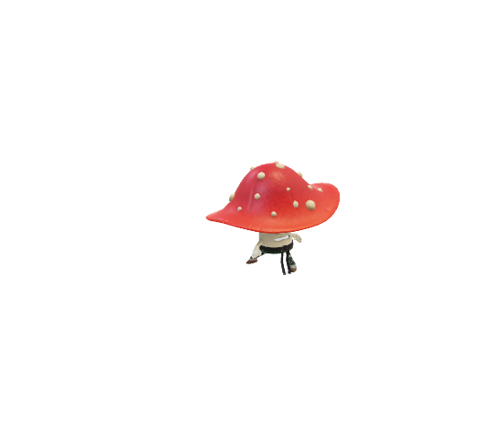
9
Notes:
What do these two dancing toadstools see? One sees a 6 the other a 9. Who is right? Is there an answer? [The person who wrote it surely knew if they meant 6 or 9?]

Slide 9
What do you see?
Do the REAL checks
Think about point of view
© BBC 2022
These workshops and slides are for educational and private study use only. They are not for resale or commercial and/or online distribution.
if you wish to use the workshops and slides for any other purpose, please contact marie.helly@bbc.co.uk
Notes:
END SLIDE.
Take the students through these tips; REAL checks and point of view, what does this look like from another position.

