Slide 1


REAL numbers!
Notes:
START
This is your start slide.

Slide 2

REAL checks
REAL
EVIDENCE
Is it real?
What is the source?
Ask around, use your knowledge
Any other sources carrying the story?
ADD IT ALL UP
LOOK AROUND
Notes:
These are the REAL checks. These questions can help us to spot fake news.
R = is it real?
E = Evidence, what evidence is there?
A = Ask questions, ask around and add it up
L = Look around, are there other sources carrying this story.
These questions can be used with stories about numbers too. Because numbers can trick us or be used to to trick us, just like words.

Slide 3

https://www.bbc.co.uk/teach/young-reporter/numbers-and-the-tricks-they-play/z8gbp4j

Slide 4

Are these numbers REAL?

Slide 5


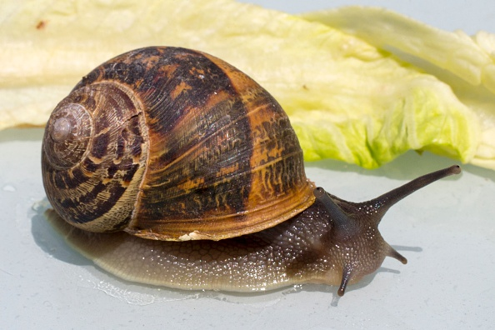
100%
Notes:
SCRIPT
OK. Let’s say you want to play the lottery and win a big jackpot of cash. From the numbers 1-49 you have to chose 6 numbers, and if they are all correct, then you with the Jackpot!
Then you get a what’s app message saying your chances of winning the lottery would improve by 100% by doing one simple thing - 100 star jumps every day – yes, just to increase your chance of becoming a millionaire by 100%, 100 star jumps a day. Who would do it?
[CLICK] What if you then got another what’s app message to say all you had to do was eat snails? To improve your chances of winning the lottery by 100% you have to eat snails. Still keen? Who would do it?
OK let’s look at it!

Slide 6
1:13,983,816
or
1:14,000,000
100%
2:14,000,000
Notes:
SCRIPT
By one calculation, your chances of winning – of getting all six numbers, chosen from 1-49 correct - are: 1 in 13,983,816 or approximately 1 in 14 million.
Increasing your chances by 100% increases this number here on the left, and increase of 100% on 1 is…..2.
[CLICK] So all of you willing to eat snails, you haven’t increased your chances very much.
Key to this is understanding numbers in their full context. Numbers rarely mean much on their own.
**How else could we have spotted that this story was not true?**

Slide 7
REAL checks
REAL
EVIDENCE
Is it real?
What is the source?
Ask around, use your knowledge
Any other sources carrying the story?
ADD IT ALL UP
LOOK AROUND
Notes:
By doing these REAL checks we may have spotted it was not true, without having to do the maths.
R = is it real? Could that be true? Whatever could the connection be between eating snails and the lottery?
E = Evidence, what evidence is there? Does the story offer you any evidence to back up what it’s saying?
A = Ask questions, ask around and add it up.
L = Look around, are there other sources carrying this story. If the story was true, wouldn’t you have found it in other places?

Slide 8
This year, 60% of school students passed their end of year exams.
Last year, 80% of school students passed their end of year exams.
Over the past ten years, 50% of school students passed their end of year exams.
Notes:
SCRIPT: One number is unlikely to ever tell you the whole story.
How does this story make you feel? Is this a good result or a bad result? Do you know people who passed or people who didn’t? Could it be true? How likely is this to be true?
What do you need to know to make sense of that number – 60%? [Let students answer. Answers that are helpful may include; what was last year’s result? What is average? Is it better or worse than ‘average’? Which exams? Which students?]
CLICK: Last year 80% of school students passed their end of year exams. What do you think now? [Let students answer]
CLICK: And now this answer. Does this change anything for you about how you see the first statement?
These two statements help us understand the number better, because they provide context.
The first sentence only gave us one number – it wasn’t enough context to really understand the story.

Slide 9
This year, 60% of school students passed their end of year exams.
This year, only 60% of school students passed their end of year exams.
This year, 60% of school students successfully passed their end of year exams.
Notes:
SCRIPT: Let’s go back to the original sentence. CLICK: Now look at this one; what’s the difference? What does that one word do? Or try to do?
CLICK: And now this one, what is different here? What is the message it is perhaps trying to convey?

Slide 10
Remember;
- use your REAL questions
one number is not enough
- each number needs context.
Notes:
START
The main take away is that one number is never enough to tell a story. It needs context, to be put into a bigger picture.

Slide 11

REAL numbers!
© BBC 2022
These workshops and slides are for educational and private study use only. They are not for resale or commercial and/or online distribution.
if you wish to use the workshops and slides for any other purpose, please contact
Notes:
END
Thank you!

