Slide 1
SUSTAINABILITY
WHAT PEOPLE THINK

Slide 2
How the UK feels about Climate Change & Sustainability today:
How people feel
What they understand
What they think we should do

Slide 3
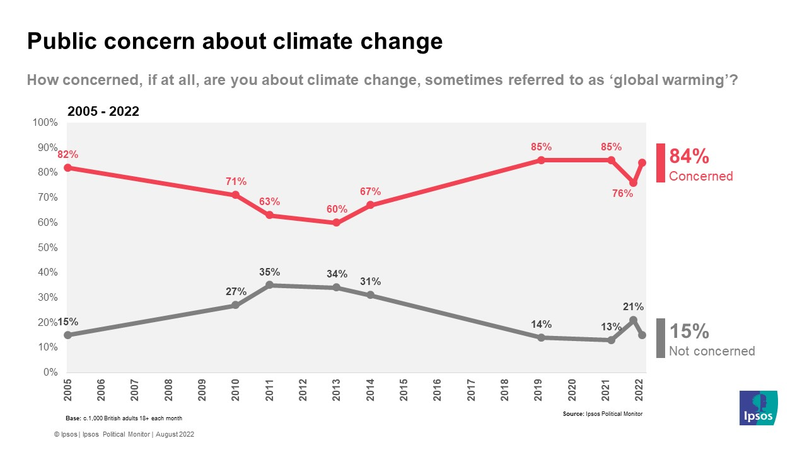
Most of the UK are worried about Climate Change
IPSOS, 2022

Slide 4
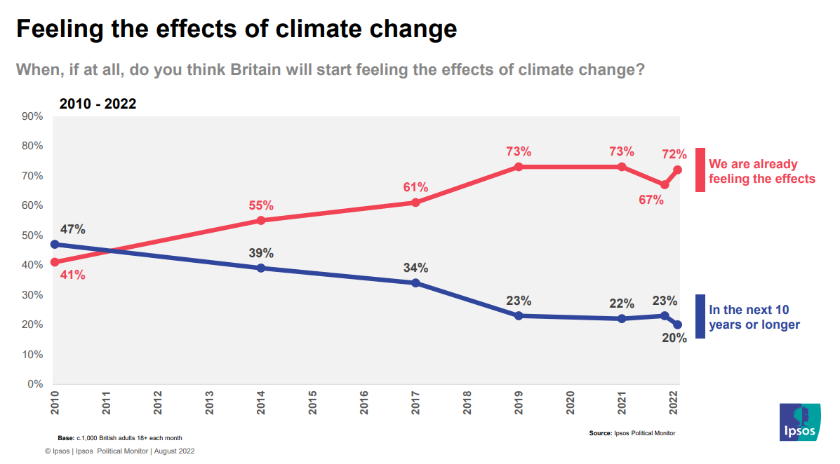
Many of us think we’re already feeling the negative effects
IPSOS, 2022

Slide 5
And most of us feel that drastic change is needed to avoid the worst effects of Climate Change
YOUGOV, MAY 2022

Slide 6
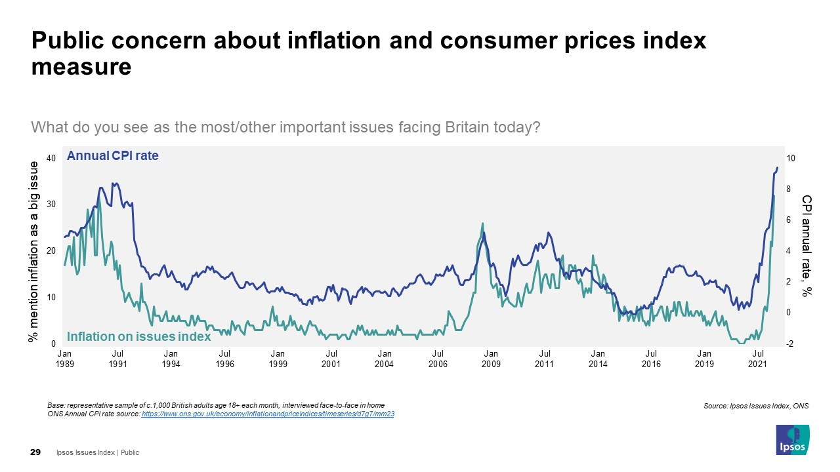
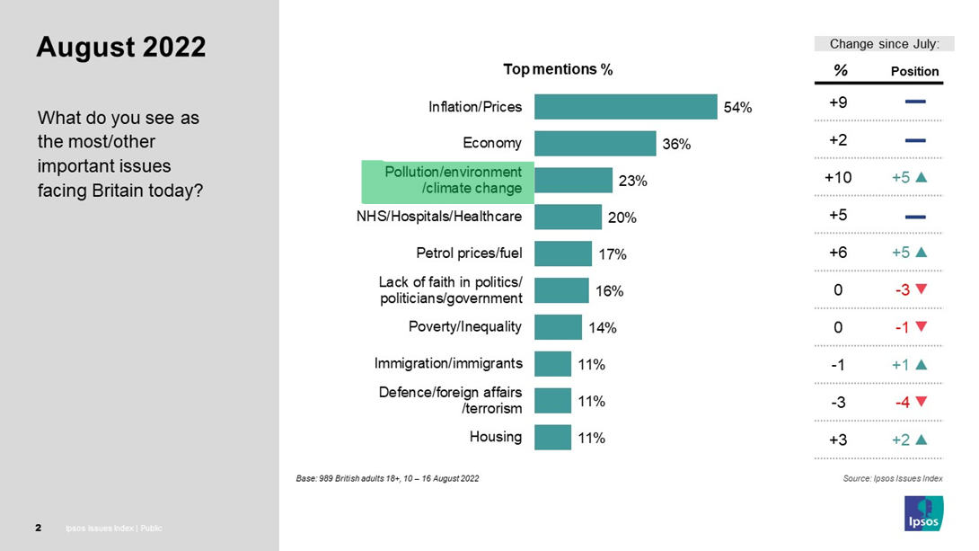
With costs spiralling, the cost of living is our biggest concern
IPSOS, 2022

Slide 7
“You can't expect a nation that is going through a poverty crisis to start spending...
people can't afford to...
they’re going to food banks….
how can you expect people to eat in a really clean and healthy way that's good for
the environment if you can't afford it?”
Given our economic outlook – we should expect the cost of living to influence people’s attitudes to sustainability
BBC QUALITATIVE RESEARCH, 2022

Slide 8
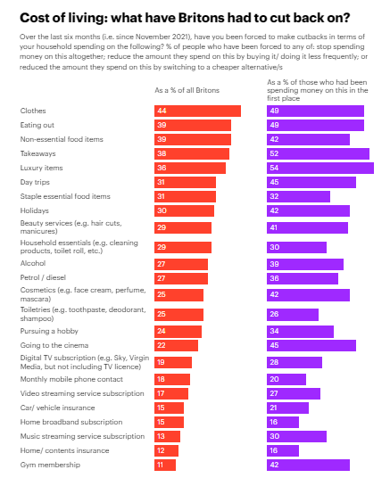
Many of the UK are already making hard choices on their budgets – and expect more to come
Some of these choices involve a smaller carbon footprint
YOUGOV, 2022

Slide 9
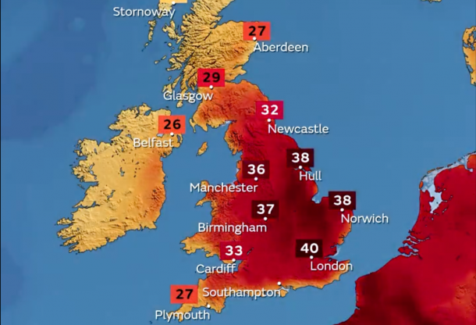
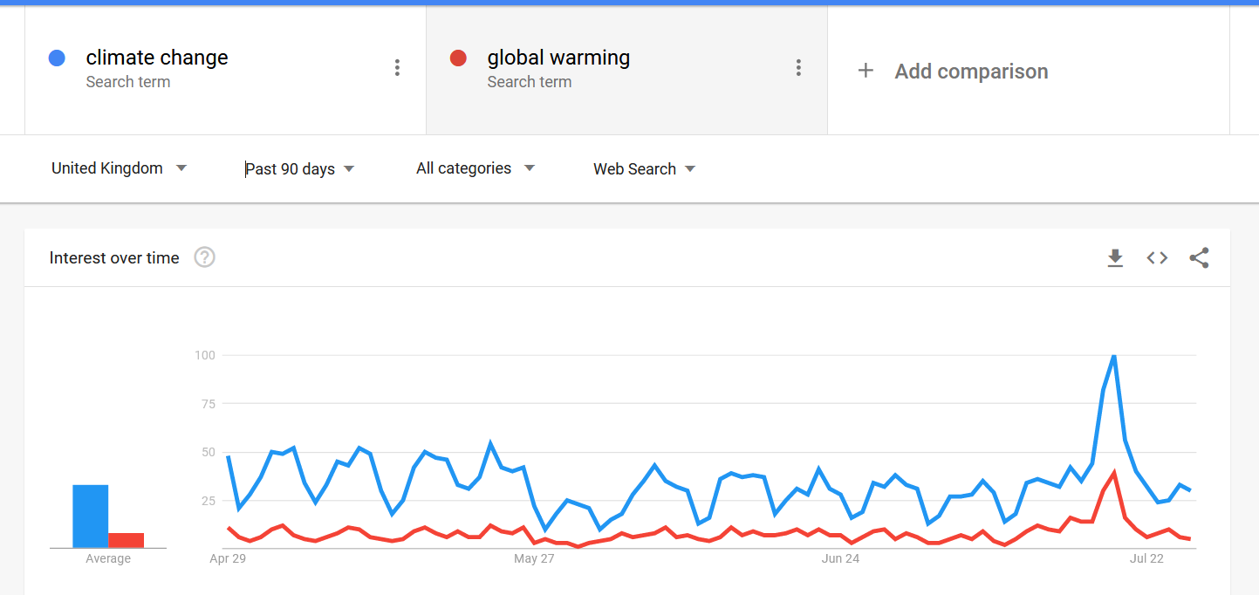
There will be moments where Climate Change is front of mind despite our economic challenges
Particularly during moments of extreme weather
Do you think heatwaves being experienced across Europe are or are not due to climate change? (July 2022)
YOUGOV, 2022

Slide 10
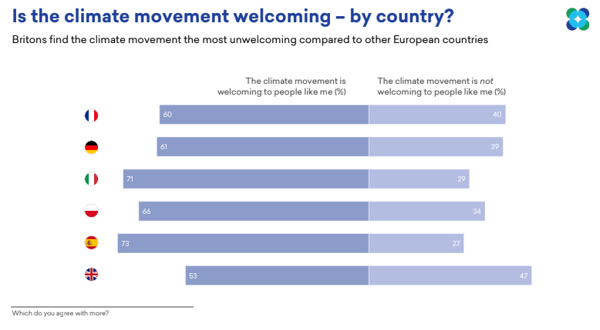
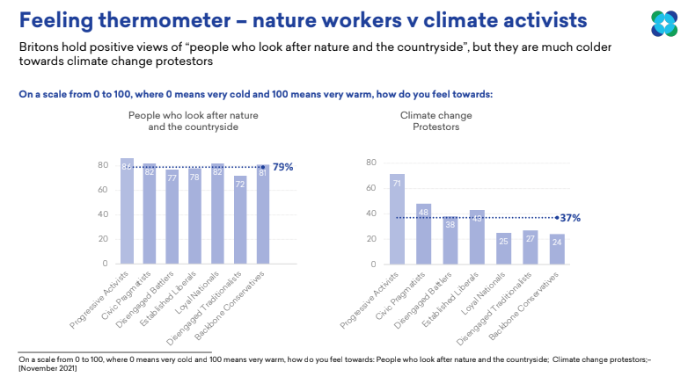
While there is widespread consensus around the threat of climate change – we’re more divided in our attitudes towards Climate activism
MORE IN COMMON

Slide 11
How people feel
What they understand
What they think we should do

Slide 12
Which statement best describes your current understanding of environmental issues?
Most of us feel like we’ve got a surface level understanding of environmental issues
BBC RESEARCH, 2022

Slide 13
To the best of your knowledge, what percentage of climate scientists have concluded that human-caused climate change is happening?
Across the UK we continue to under-estimate the level of scientific consensus around Climate Change
65%
THE AVERAGE ESTIMATE BY UK ADULTS
99.9%
THE ACTUAL LEVEL OF SCIENTIFIC CONSENSUS
KINGS COLLEGE LONDON, JUNE 2022

Slide 14
How well would you say you understand what the following words or phrases mean?
It can be a challenge to keep up with new terms – a third of the country don’t know what Net Zero means
BBC RESEARCH, 2022

Slide 15
Which of the following, if any, would you like to know more about?
(asked to all respondents)
The country is most interested in positive, practical tips that they can apply in their daily lives – as well as understanding how governments are responding
BBC RESEARCH, 2022

Slide 16
How people feel
What they understand
What they think we should do

Slide 17
Q: Thinking mainly about how things might change in the UK, do you think any of these groups below should do more, less, or the same as they do at the moment – around protecting the environment and transitioning to a more sustainable world?
Most of the UK feels that more needs to be done to protect our environment – and it’s a job for the whole country
BBC RESEARCH, 2022

Slide 18
Thinking about coverage of environmental issues
Which of these are you most interested in?
People recognise this is a global issue – and want a global perspective
Information about
the UK
22%
Equally interested in information about
the UK and the world
45%
Info about
the world
16%
Don’t
know
16%
BBC RESEARCH, 2022

Slide 19
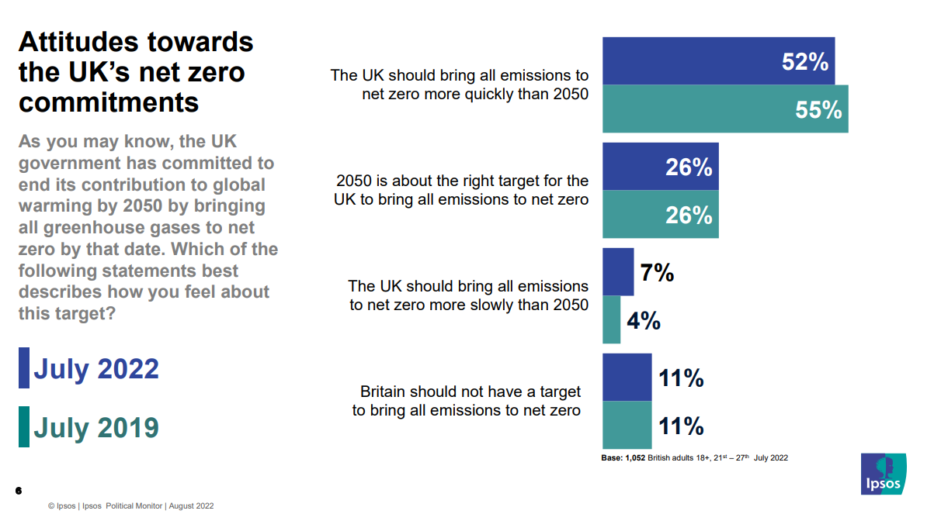
There’s widespread support for our Net Zero targets
More than half of the UK think we should move faster
IPSOS, 2022

Slide 20
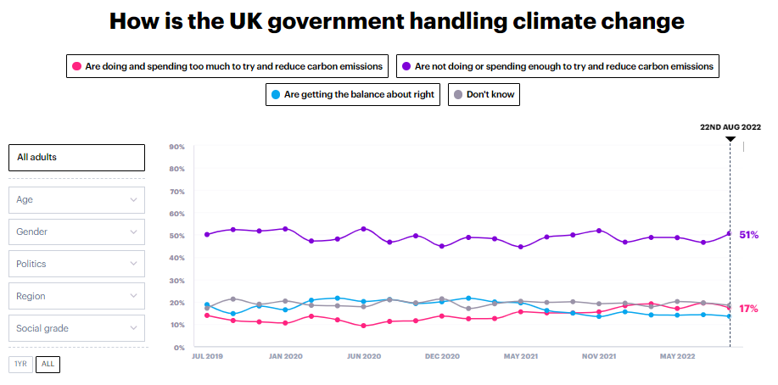
Most people feel that we’re not doing enough to reduce Carbon emissions
NOT DOING ENOUGH TO TRY AND REDUCE CARBON EMISSIONS
YOUGOV, 2022

Slide 21
Taking into account the personal costs or changes to lifestyle that would be required, please say whether you would or would not be willing to do each of the following to address climate change
(% willing)
At an individual level – some sustainable options are much more appealing than others
IPSOS. 2022

Slide 22
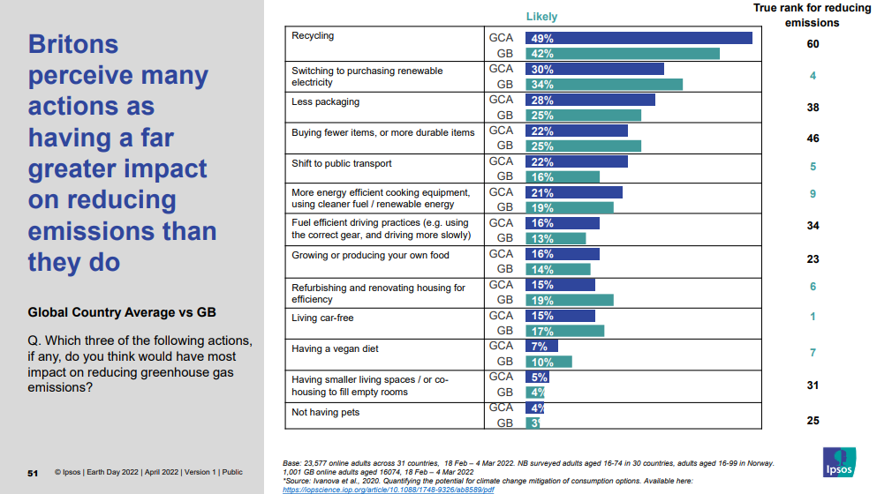
Many of us don’t really know what the most impactful actions are that we could take
IPSOS EARTH DAY REPORT, 2022

Slide 23
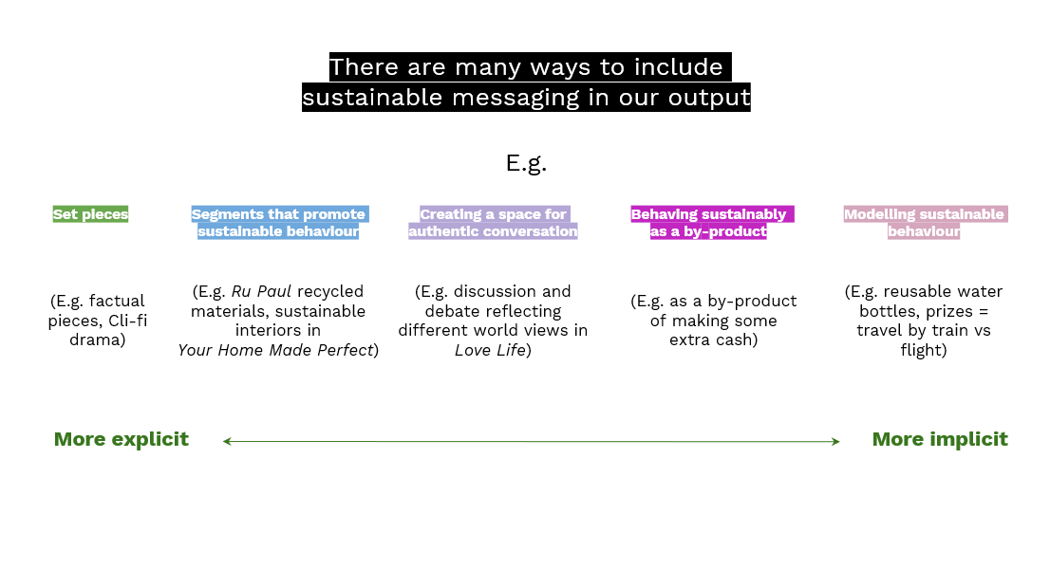
The media has an important role to play in helping us to tackle our Climate challenge
BBC SUSTAINABILITY TOOLKIT

Slide 24
Have you seen, heard or read anything in the last three months that has made you think about doing things in a sustainable way?
“I watched David Attenborough
“Coronation Street have been covering environmental protests & clothes manufacturing ”
“I saw F1 promoting ‘Go Green’”
People say they’ve been inspired to act sustainably by a wide range of media
“The BBC talking about the cost of living”
“Early morning TV shows explain how we can adjust our lifestyles”
“I saw a tip on TV – only fill the kettle with the water you need to brew”
“I watched a Stacey Dooley investigative programme”
“I listened to a documentary saying that animals can cause pollution – this reinforced my choice to go vegetarian”
BBC RESEARCH, 2022

Slide 25

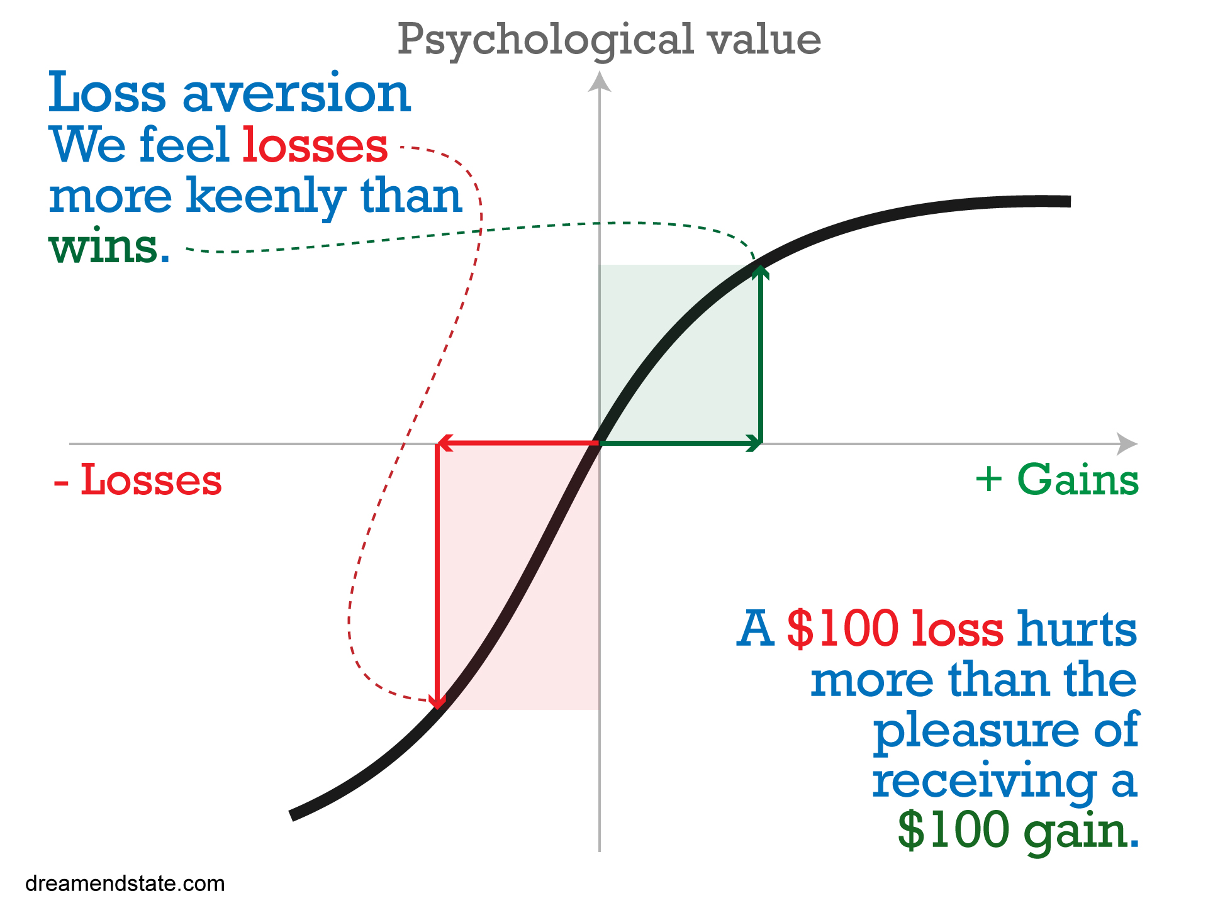
People are hard-wired to be avoid a sense of loss
We’re more likely to be inspired to change our habits when we can see how it might improve our lives

Slide 26
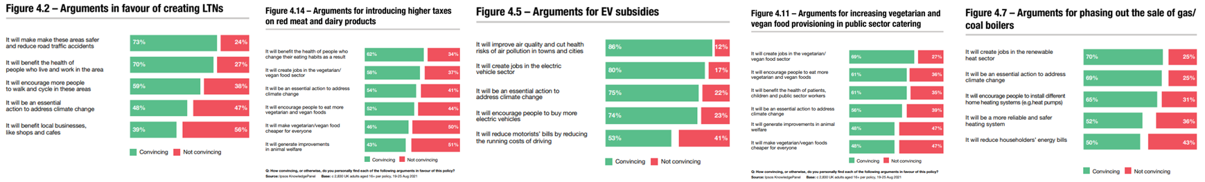
What are the most compelling arguments for Net Zero policies?
Often benefits beyond Climate Change are a compelling reason for change
IMPROVING DAILY LIFE
It will benefit my health
It will improve our air quality
It will make my area safer
It will encourage people to be more active
ECONOMIC OPPORTUNITY
It will create new jobs
It will create new sectors
It will encourage sustainable investments
IPSOS, 2022

Slide 27
What prompted you to… (adopt a sustainable behaviour)
“To save money”
“Because it’s the right thing to do. And to save money”
“The rising cost of living”
Often benefits beyond Climate Change are a compelling reason for change
“I wanted to
get fitter”
“I wanted to
get healthier”
“I reduced my meat consumption to help me to lose weight”
“My great granddaughter talked to me about it ”
“I worry about my child’s future”
“Speaking to my granddaughter”
BBC RESEARCH, 2022

Slide 28
#1: Don’t assume knowledge
#2: Talk to the mainstream
#3: Show solutions
#4: Share success stories

